Slide 1
THE MESSIAH, THE PROMISED SON OF ABRAHAM, ISAAC, ISRAEL, AND KING DAVID--
THE LORD JESUS CHRIST:
What is the Evidence?

Slide 2
Purpose of this Message
1. To review some of the details regarding the birth and life of Messiah Yeshua [Jesus] as presented in the Bible.
2. To remind Christians that we can believe the Bible—it is true although not exhaustive.
3. To encourage non-Christians to investigate the Biblical prophecies about the Deliverer Messiah and the salvation that is in Him alone.

Slide 3
Jesus said,
“These are the words which I spake unto you, while I was yet with you, that all things must be fulfilled, which were written in the law of Moses, and in the prophets, and in the psalms, concerning me.”
Luke 24:44
Yeshua [Jesus] was referring to the Tanakh
or Old Testament. A good starting place there is Isaiah 53.
Notes:
.

Slide 4
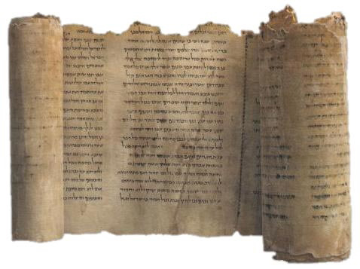
What things were written in the law of Moses, and in the prophets, and in the psalms, concerning Jesus?

Slide 5
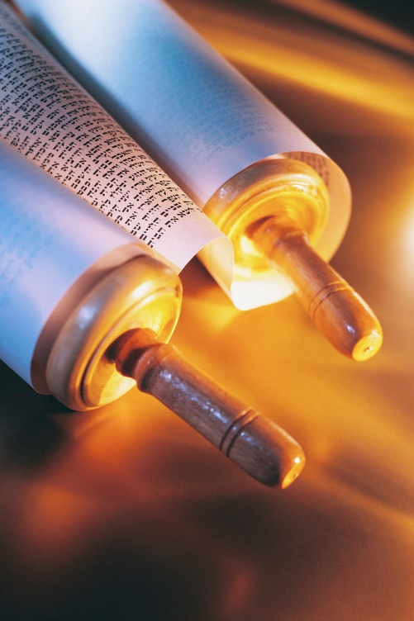
The Messiah in O.T. Prophecy and N.T. Fulfillment
He Would be the “Seed of a Woman.” Gen. 3:15 **** Gal. 4:4, Lk. 2:7, Rev.12:5
Promised seed of Abraham Gen. 18:18 **** Matt. 1:1, Lk. 3:34
Promised seed of Isaac Gen. 17:19 **** Matt. 1:2, Lk. 3:34
Promised seed of Israel [Jacob] Num. 24:17 **** Matt. 1:2, Lk. 3:34

Slide 6
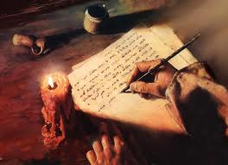
The Messiah in O.T. Prophecy and N.T. Fulfillment
Messiah to be from tribe of Judah — Gen. 49:10 **** Matt. 1:2, 3; Lk. 3:33
Heir to the throne of David—Isaiah 9:7 **** Matt. 1:1, 6
To be born in Bethlehem —Micah 5:2 **** Matt. 2:1; Lk. 2:4-7
Time of birth prophesied — Daniel 9:25 **** Luke 2:1-7
Jesus to be born of a virgin — Isaiah 7:14 **** Matt. 1:18; Lk. 1:26-35

Slide 7
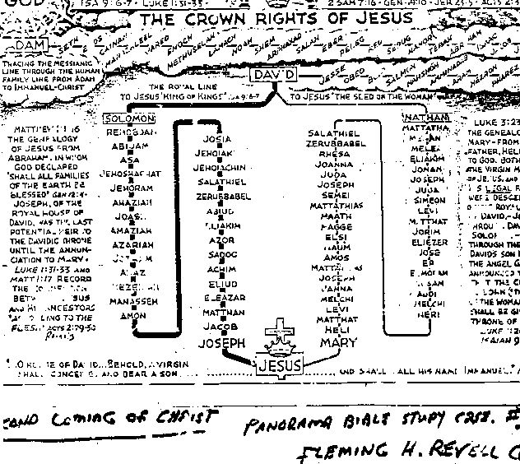
Royal
Legal
Lines
curse
Jesus was the heir to David’s throne, legally and royally!!
Jesus had no children=end of the Davidic kings!

Slide 8
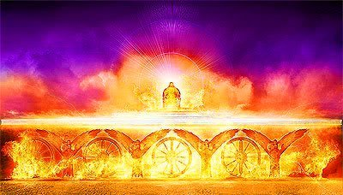
The Davidic Throne
Messiah was to inherit the throne of David.
Jesus inherited the royal and legal right to the throne.
Jesus never married and He had no children.
The right to the throne of David ended with Jesus.

Slide 9
The Curse
Jehoiachin, king of Judah, was taken into captivity by Nebuchadnezzar in 597 B.C.
Jeremiah referred to Jeoiachn as Coniah (Jer. 22:24).
A curse was pronounced on Coniah that none of his descendents would prosper sitting on the throne of David. Had our Lord Jesus been the biological son of Joseph He could not be successful on the throne of David because of this curse. But since He came biologically only through Mary’s lineage, He was not affected by this curse of Jehoiachin.

Slide 10
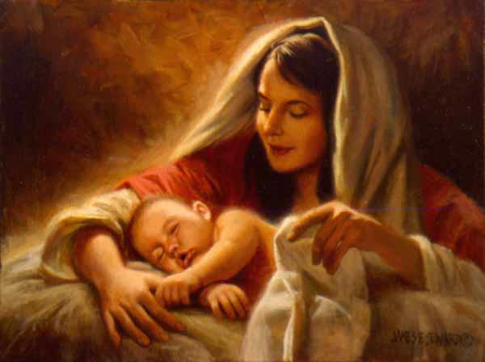
One More Thing:
In Matthew 1:16 the word “of Whom” is in the feminine singular. This indicates clearly that Jesus was born of Mary only and not of Mary and Joseph. It is one of the strongest evidences for Jesus’ virgin birth!

Slide 11
Matthew 1:16
And Jacob begat Joseph the husband of Mary, of whom (feminine) was born Jesus, who is called Christ.

Slide 12
Here are some more prophecies concerning the First Coming [First Advent] of the Messiah of the Tanakh [Old Testament] and their fulfillment in the advent of Jesus in the New Testament:

Slide 13
Massacre of infants prophesied—Jeremiah 31:15 **** Matt.2:16-18
Jesus would spend time in Egypt—Hosea 11:1 **** Matt. 2:14-15
Messiah would minister in Galilee—Isaiah 9:1-2 **** Matt. 4:12-16
He would be a prophet —Deut. 18:15 **** John 6:14;1:45
He would be a priest like Melchizedek —Psalm 110:4 **** Hebrews 6:20; 5:5-6

Slide 14
Jesus was to be rejected by his people—Isaiah 53:3; Ps. 2:2 **** John1:11, 5:43
Characteristics of Jesus were prophesied—Isaiah 11:2; Ps. 45:7 **** Lk. 2:52; 4:18
Triumphal entry to Jerusalem prophesied—Zech. 9:9; Isa. 62:11 **** John 12:13-14
Messiah to be betrayed by a friend—Psalm 41:9 **** Mark 14:10
Messiah to be sold for thirty pieces of silver— Zech. 11:12-13 **** Matt. 20:15; 27:3-10

Slide 15
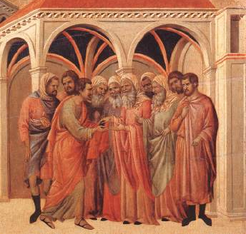
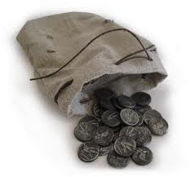
Silver to be returned for a Potter’s Field—Zech. 11:13 **** Matt. 27:3-10 Judas’ office to be taken over by another— Psalm 109:7-8 **** Acts 1:16-20
False witnesses to accuse Messiah —Psalm 27:12; 35:11 **** Matt. 26:60-61
Messiah would be silent when accused— Isaiah 53:7; Ps. 38:13 **** Matt 26:62-63
He would be smitten and spat upon— Isaiah 50:6 **** Mark 14:65; 15:17; Jn. 19

Slide 16
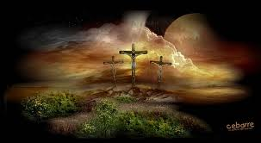
Messiah would be hated without a cause—Psalm 69:4;109:3-5 **** John 15:23-25
Messiah was to suffer for the sins of others— Isaiah 53:4-12 **** Matt. 8:16-17; Rom. 4:25
Immanuel would be crucified with sinners Isaiah 53:12 **** Matt. 27:38; Luke 23:33
Messiah’s hands and feet to be pierced Psalm 22:16; Zech. 12:10 **** Jn. 19:17-37
Jesus would be mocked and insulted Psalm 22:6-8 **** Matt. 27:39-44; Mk. 15

Slide 17
Messiah to be given gall and vinegar—Psalm 69:21 **** Jn. 19:29, Matt. 27:34,48
He would hear the Scriptures mocked—Psalm 22:8 **** Matt. 27:43
Messiah would pray for his enemies—Psa. 109:4; Isa. 53:12 **** Luke 23:34
Messiah’s side was to be pierced—Zechariah 12:10 **** John 19:34
Soldiers would cast lots for his coat— Psalm 22:18 **** Mark 15:24, John 19:24

Slide 18
Messianic prophecies are all fulfilled literally and historically
Messiah’s bones were not to be broken—Psalm 34:20; Exod. 12:46 **** John 19:33
Messiah would be buried with the rich—Isaiah 53:9 **** Matt. 27:57-60
Messiah would be resurrected from the dead—Psalm 16:10 **** Matt. 16:21; 28:9, Lk. 24
Messiah would ascend up to Heaven— Psalm 68:18 **** Lk. 24:500-51; Acts 1:9

Slide 19
His First Coming
The Messiah was to descend from heaven and enter the human race as a baby.

Slide 20
Galatians 4:4-5
⁴But when the fulness of the time was come, God sent forth his Son, made of a woman, made under the law, ⁵To redeem them that were under the law, that we might receive the adoption of sons.

Slide 21
The Purpose of His First Coming
He came to die by crucifixion (as the unblemished sacrificial lamb) on behalf of all sinful people.

Slide 22
John 19:16-18
¹⁶Then delivered he him therefore unto them to be crucified. And they took Jesus, and led him away. ¹⁷And he bearing his cross went forth into a place called the place of a skull, which is called in the Hebrew Golgotha: ¹⁸Where they crucified him, and two others with him, one on either side, and Jesus in the midst.

Slide 23
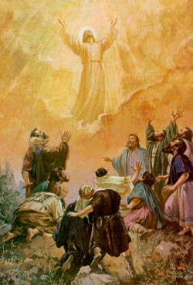
The Result of His First Coming
He conquered death at His resurrection, ascended to heaven as our advocate, and then will return to earth in the future as the sovereign King of Kings to rule the world from Jerusalem.

Slide 24
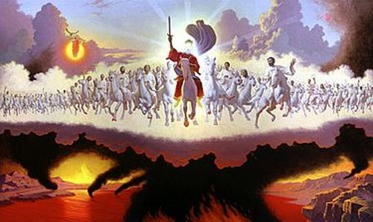
The Messiah was to descend from heaven and enter the human race as a baby, ultimately to die of crucifixion as the unblemished sacrificial lamb on behalf of all sinful people, to conquer death at His resurrection, ascend to heaven as our advocate, and then return to earth as the sovereign King of Kings to rule the world from Jerusalem.

Slide 25
The Events of His Birth, Death, and Resurrection Were Prophesied . . .
Messiah would be born in human flesh Isaiah 7:14; Micah 5:2
Messiah would manifest His glory with miracles John 2
Messiah would be sacrificed for our sins Isaiah 53

Slide 26
What does the historical evidence show?
Messiah died, the evidence: He was buried 1 Corinthians 15
Messiah rose from the dead [resurrection] Matthew 28:7
The evidence He arose—He was seen (500+) 1 Corinthians 15:5-8

Slide 27
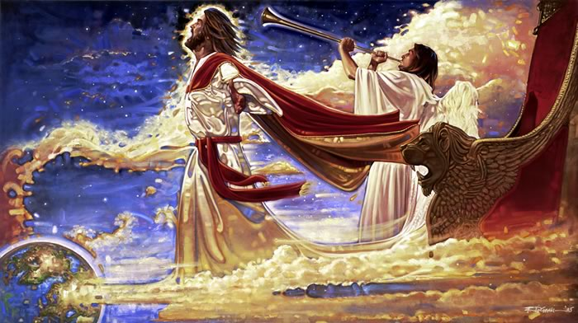
Messiah ascended into heaven (seen) Psalm 68:18; Acts 1:9
Messiah sits at the right hand of God Hebrews 10:12
Messiah is coming to earth again to rule Revelation 19:11

Slide 28
“And when [Jesus] had spoken these things, while they beheld, he was taken up; and a cloud received him out of their sight. And while they looked steadfastly toward heaven as he went up, behold, two men stood by them in white apparel; which also said, Ye men of Galilee, why stand ye gazing up into heaven? This same Jesus, which is taken up from you into heaven, shall so come in like manner as ye have seen him go into heaven.” ACTS 1:9-11

Slide 29
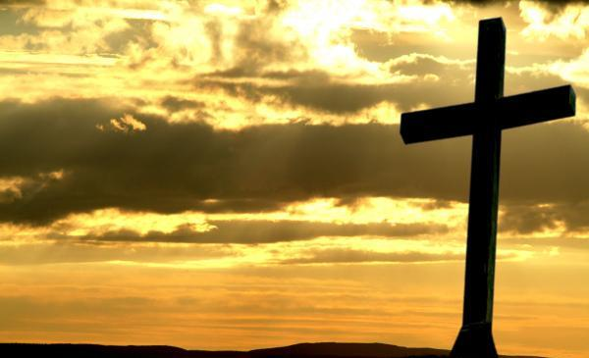
His Sacrifice
On the cross Jesus said, “MY GOD, MY GOD, WHY HAST THOU FORSAKEN ME?”
PSALM 22:1a
His sacrifice for us—a sinful human race—is difficult to comprehend.

Slide 30
King David Prophesied in the about Psalms Jesus’ Agony
“All they that see me laugh me to scorn.”
“I am poured out like water, all my bones are out of joint: my heart is like wax; it is melted in the midst of my bowels.”
“My strength is dried up like a potsherd: and my tongue cleaveth to my jaws….”
“They pierced my hands and my feet.”
PSALM 22:7a, 14, 15a, 16b.

Slide 31
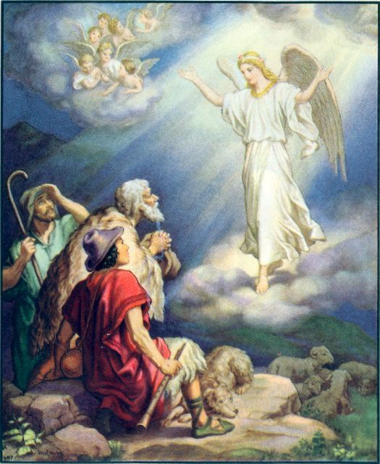
His Significance Prophesied
For unto us a child is born, unto us a son is given: and the government shall be upon his shoulder: and his name shall be called Wonderful Counsellor, the mighty God, the everlasting Father, the Prince of Peace. Isaiah 9:6

Slide 32
His Purpose and Identity: Proclaimed by Angels
“For unto you is born this day in the city of David a Saviour, which is Christ the Lord.” Luke 2:11
Prophesied Long Before His Birth . . .

Slide 33
Luke 1:30
³⁰And the angel said unto her, Fear not, Mary: for thou hast found favour with God. ³¹And, behold, thou shalt conceive in thy womb, and bring forth a son, and shalt call his name JESUS. ³²He shall be great, and shall be called the Son of the Highest: and the Lord God shall give unto him the throne of his father David: ³³And he shall reign over the house of Jacob for ever; and of his kingdom there shall be no end.

Slide 34
Matthew 1:20b-23
Joseph, thou son of David, fear not to take unto thee Mary thy wife: for that which is conceived in her is of the Holy Ghost. ²¹And she shall bring forth a son, and thou shalt call his name JESUS: for he shall save his people from their sins. ²²Now all this was done, that it might be fulfilled which was spoken of the Lord by the prophet, saying, ²³Behold, a virgin shall be with child, and shall bring forth a son, and they shall call his name Emmanuel, which being interpreted is, God with us.

Slide 35
“Therefore the Lord himself shall give you a sign; Behold, a virgin [Heb. Almah] shall conceive, and bear a son, and shall call his name Immanuel.”
Isaiah 7:14

Slide 36
Genesis 24:43-44
Behold, I stand by the well of water; and it shall come to pass, that when the virgin [Heb. Almah] cometh forth to draw water, and I say to her, Give me, I pray thee, a little water of thy pitcher to drink; ⁴⁴And she say to me, Both drink thou, and I will also draw for thy camels: let the same be the woman whom the LORD hath appointed out for my master’s son.
In the context of Isaiah 7:14 “almah” means virgin.

Slide 37
In the Tanakh, the Old Testament, it is told beforehand that the Messiah would eventually come to mankind. He would be the seed of Abraham, Isaac and Jacob, the seed of King David, be born in Bethlehem, the city of David, rule in Jerusalem [the location of the throne of David], and die in Jerusalem , the place where David died.

Slide 38
Consider the Parallels King David’s Life to That of Jesus
So David slept with his fathers, and was buried in the city of David. And the days that David reigned over Israel were forty years: seven years reigned he in Hebron, and thirty and three years reigned he in Jerusalem. 1 Kings 2:10-11

Slide 39
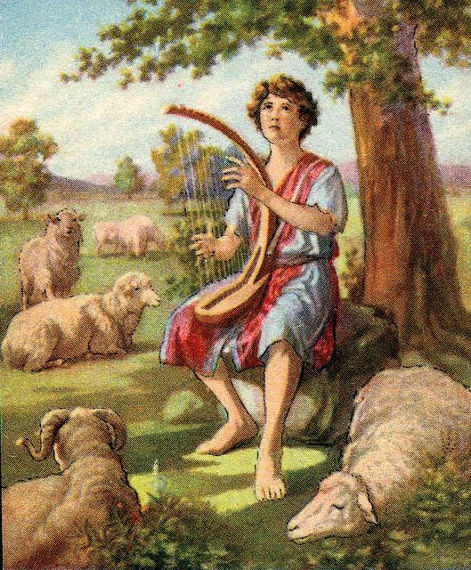
1 Samuel 17:15
“But David went and returned from Saul to feed his father’s sheep at Bethlehem.”
David’s hometown and his place of birth was Bethlehem.
David shepherded sheep in the very area that the sheep destined to be sacrificed in the Jerusalem temple in Jesus day were raised.
Accessed on 12-17-11 from: http://bibleclipart.blogspot.com/2010/01/united-kingdom-miscellaneous-16.html

Slide 40
Micah 5:2
But thou, Bethlehem Ephratah, though thou be little among the thousands of Judah, yet out of thee shall He come forth unto me that is to be ruler in Israel; whose goings forth have been from of old, from everlasting.
Hebrew: “the days of eternity”
Messiah was to be born in Bethlehem.

Slide 41
1 Samuel 16:1
And the LORD said unto Samuel, How long wilt thou mourn for Saul, seeing I have rejected him from reigning over Israel? fill thine horn with oil, and go, I will send thee to Jesse the Bethlehemite: for I have provided me a king among his sons.

Slide 42
1 Samuel 16:17-19
¹⁷And Saul said unto his servants, Provide me now a man that can play well, and bring him to me. ¹⁸Then answered one of the servants, and said, Behold, I have seen a son of Jesse the Bethlehemite, that is cunning in playing, and a mighty valiant man, and a man of war, and prudent in matters, and a comely person, and the LORD is with him. ¹⁹Wherefore Saul sent messengers unto Jesse, and said, Send me David thy son, which is with the sheep.

Slide 43
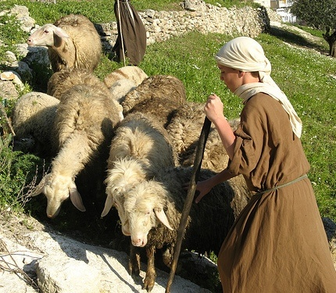
King David was a Bethlehemite and tended sheep close to the Jerusalem temple mount!

Slide 44
1 Samuel 17:12
Now David was the son of that Ephrathite of Bethlehemjudah, whose name was Jesse.

Slide 45
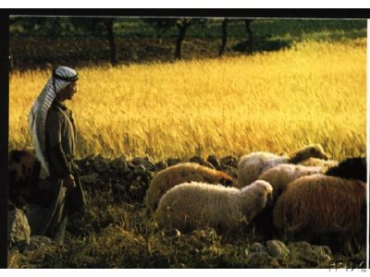
The father of David, Jesse the Bethlehemite, appears to have been well known in his day.
Could it be that Jesse’s flock which David shepherded was the flock that provided the sacrificial lambs and that is why Jesse was well known?

Slide 46
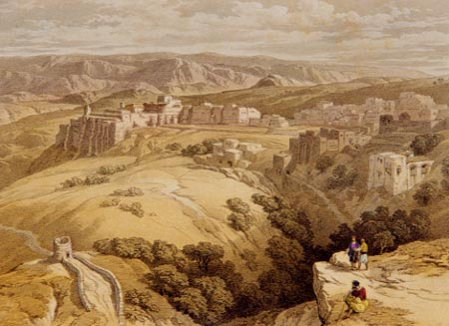
Most of the lineage and history of the Messiah of the Bible is rooted in the area of Israel surrounding Bethlehem.
There is also significant typology in the names and places.

Slide 47
Genesis 35:16-17
¹⁶And they journeyed from Bethel; and there was but a little way to come to Ephrath: and Rachel travailed, and she had hard labour. ¹⁷ And it came to pass, when she was in hard labour, that the midwife said unto her, Fear not; thou shalt have this son also.

Slide 48
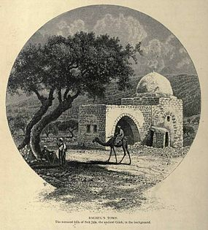
Genesis 35:18-20
¹⁸And it came to pass, as her soul was in departing, (for she died) that she called his name Benoni: but his father called him Benjamin. ¹⁹And Rachel died, and was buried in the way to Ephrath, which is Bethlehem. ²⁰And Jacob set a pillar upon her grave: that is the pillar of Rachel’s grave unto this day.

Slide 49
Genesis 49:22
Ephrath = “place of fruitfulness”
Messiah was to be born here.

Slide 50
Bethel = “house of God” (Beyth-’ El-)
He came from the house of God.

Slide 51
Rachel means “little ewe or lamb”
The female lamb was used for the peace offerings in the temple.
The Messiah became our peace offering with our Heavenly Father.

Slide 52
Ben-’Owniy = Benoni, “son of my pain” or “son of my sorrow”
Messiah became the Son of Sorrow.
Benjamin = “son of the right hand”
Messiah is the strong right hand of God.

Slide 53
Beth-lechem = “house of bread”
Messiah came from the “house of bread” to become the “Bread of Life.”

Slide 54
In Genesis 35:10 Jacob’s name is changed to “Israel.”
And God said unto him, Thy name is Jacob: thy name shall not be called any more Jacob, but Israel shall be thy name: and he called his name Israel.
Israel = “God prevails” or “He will rule as God.”
Soon Yeshua will rule as God/King on Earth!

Slide 55
Migdol-Eder (Edar)
Migdol = “tower”
Eder or Edar = “flock” or “sheep fold”
And Israel [Jacob] journeyed, and spread his tent beyond the tower [Migdol] of Edar.
Genesis 35:21
Migdol-Edar was a tower to guard the sheep against predators and robbers.

Slide 56
Proverbs 18:10
The name of the LORD is a strong tower: the righteous runneth into it, and is safe.
Our Messiah is our “strong tower” and we run to Him and are safe!

Slide 57
It is quite possible that Joseph, with Mary in early labor and no room for them in the inn, “ran” to the nearest shelter which could have been Migdol-Eder, the tower of the sheep.
The tower was not just a pillar, but a place where shepherds could spend the night or climb the stairs to keep watch over the sheep.

Slide 58
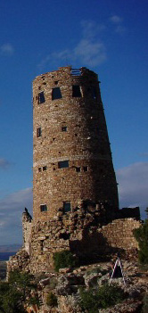
Migdol-Eder
This is very likely the same tower that the priests would enter to ready the lambs for the temple sacrifices.

Slide 59
Luke 2:11-12
The angel said to the shepherds: “For unto you is born this day in the city of David a Saviour, which is Christ the Lord. ¹²And this shall be a sign unto you; Ye shall find the babe wrapped in swaddling clothes, lying in a manger.”
Notice: The shepherds were not given any directions as to the whereabouts of the Manger!

Slide 60
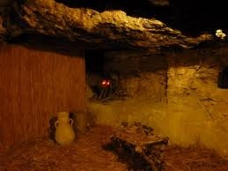
Since the shepherds were not given directions to the manger it must have been understood that they would know where the manger was.
There must have been only one manger that the temple shepherds used for the sacrificial lambs and that may very well have been on the first floor of the tower of the flock—Migdol – Eder!

Slide 61
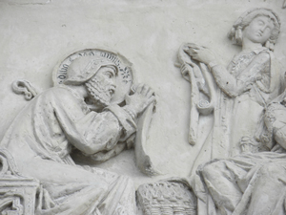
Migdol-Eder
This was the “tower of the flock” where the priests would clean the sacrificial lambs with swaddling cloths and examine them for perfection.
When the shepherds heard that the babe was wrapped in swaddling cloths they would know exactly where to go to find the manger.
Jesus may have been wrapped in these cloths.

Slide 62
Micah 5:2
But thou, Bethlehem Ephratah, though thou be little among the thousands of Judah, yet out of thee shall He come forth unto me that is to be ruler in Israel; whose goings forth have been from of old, from everlasting.
Hebrew: everlasting = “the days of eternity”

Slide 63
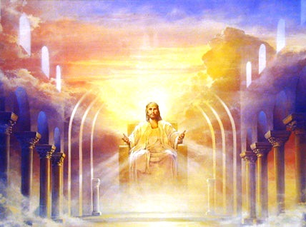
Messiah, the prophesied Savior and Ruler of Israel will come from Bethlehem.
Matthew 2:6
And thou Bethlehem, in the land of Juda, art not the least among the princes of Juda: for out of thee shall come a Governor, that shall rule my people Israel.

Slide 64
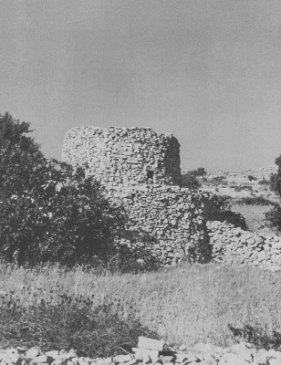
According to Edersheim, The Life and Times of Jesus, Book 2, Chapter 6
Migdol Edar was not “the watchtower for the ordinary flocks that pastured on the barren sheep ground beyond Bethlehem, but it lay close to the town, on the road to Jerusalem.”

Slide 65
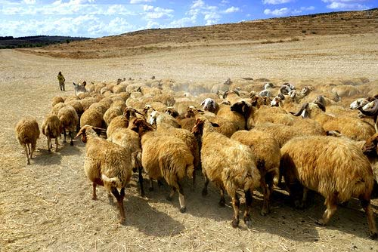
The Hebrew Mishnah, Shekelim 7:4
“…the flocks which pastured there [Migdol –Edar] were destined for Temple sacrifices.

Slide 66
Migdol-Eder is mentioned in the Hebrew Targums
Targum Yonatan paraphrases Genesis 35:23 and Micah 4:8 as: “He spread his tent beyond Migdol Eder, the place where King Messiah will reveal Himself at the end of days.”
Genesis 35:21 places Migdol Edar in reference to Bethlehem.
Micah 4:7-8 places Migdol Edar in reference to Jerusalem.

Slide 67
Both Bethlehem and Jerusalem are identified with Migdol Edar, the Tower of the Flock.
Both Bethlehem and Jerusalem are important to the prophecies and life of YHWH, Lord Jesus, the Messiah and King of Israel.

Slide 68
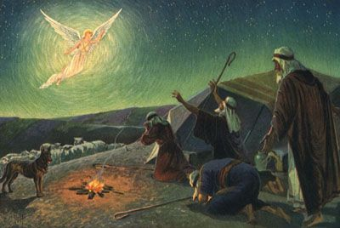
Messiah Jesus was born in Bethlehem, the place where the sacrificial sheep were born and cared for. He would ultimately become the perfect, sinless, unblemished sacrificial lamb which would be crucified in Jerusalem!
The sacrificial lambs were offered as sacrifices in Jerusalem.

Slide 69
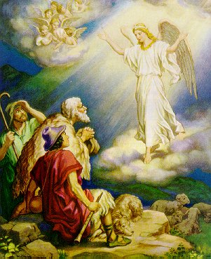
The angel said to the shepherds: “For unto you is born this day in the city of David a Saviour, which is Christ the Lord. ¹²And this shall be a sign unto you; Ye shall find the babe wrapped in swaddling clothes, lying in a manger.”
Notice: The babe is wrapped in “swaddling clothes.”

Slide 70
What are *swaddling clothes*?
Swaddling clothes were cloths that the priests used to prepare the lambs for sacrifice. They were also linens that women would wear under their main clothing when they travelled so that they could be buried in their own linens if they died on the trip. This was the custom among Middle Eastern women in Jesus’ day. It was culturally the proper thing to do.

Slide 71
If swaddling cloths were customarily burial linens then The Messiah, The Lord Jesus, Yeshua, was wrapped in burial cloths immediately after His birth!
This would be another unmistakable sign to the temple shepherds that the Messiah Who would sacrifice His life for His sheep was this baby wrapped in burial cloths perhaps even the swaddling clothes of His mother [Isaiah 53].

Slide 72
Mark 10:45
Jesus said in speaking of Himself, “For even the Son of man came not to be ministered unto, but to minister, and to give his life a ransom for many.”
God’s Own Spotless, Sinless, Sacrificial Lamb Had Come wrapped in burial cloths at His birth!

Slide 73
The shepherds that raised and cared for the sacrificial sheep were the first people that the word of the birth of the Savior was delivered to by the angels.
The Lamb of God had been born.
Technically the temple shepherds were out of a job! No more sacrificial animals should ever be needed again! The Messiah had come!

Slide 74
1 Peter 1:18-20
Forasmuch as ye know that ye were not redeemed with corruptible things, as silver and gold, from your vain conversation received by tradition from your fathers; ¹⁹But with the precious blood of Christ, as of a lamb without blemish and without spot: ²⁰Who verily was foreordained before the foundation of the world, but was manifest in these last times for you.

Slide 75
1 Corinthians 5:7-8
For even Christ our Passover [lamb] is sacrificed for us: ⁸Therefore let us keep the feast, not with old leaven, neither with the leaven of malice and wickedness; but with the unleavened bread of sincerity and truth.

Slide 76
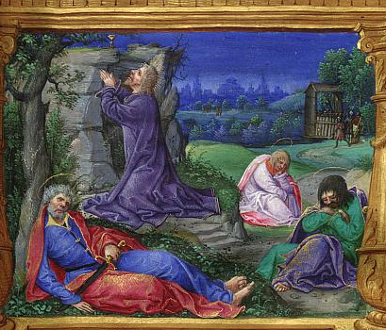
Hebrews 5:7-9
⁷Who in the days of his flesh, when he had offered up prayers and supplications with strong crying and tears unto him that was able to save him from death, and was heard in that he feared; ⁸Though he were a Son, yet learned he obedience by the things which he suffered; ⁹And being made perfect, he became the author of eternal salvation unto all them that obey him.

Slide 77
What is the significance of all of this?
Migdol-Edar [tower of the flock] links Bethlehem with Jerusalem Gen. 35:21, Micah 4:7-8
Migdol-Edar was the watchtower that guarded the flocks raised for temple sacrifices.
Jesus was born where the sacrificial lambs were born near if not in Migdol-Eder.
Jesus was born and placed in a manger which was well known to the shepherds.
Jesus was wrapped in swaddling cloths which were most probably burial linens.

Slide 78
What is the significance of all of this?
Jesus was wrapped in swaddling cloths which were most probably burial linens.
Jesus would ultimately have a triumphal entry into Jerusalem as King of the Jews [Matthew 21:4-11].
Jesus would be rejected by the religious leaders and people of His day and be crucified at Calvary, Jerusalem [Isaiah 53, Psalm 22, Luke 23].

Slide 79
Matthew 21:4-7
⁴All this was done, that it might be fulfilled which was spoken by the prophet, saying, ⁵Tell ye the daughter of Sion, Behold, thy King cometh unto thee, meek, and sitting upon an donkey, and a colt the foal of an donkey. ⁶And the disciples went, and did as Jesus commanded them, ⁷And brought the donkey and the colt, and put on them their clothes, and they set him thereon.

Slide 80
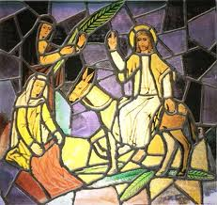
Matthew 21:8-9
And a very great multitude spread their garments in the way; others cut down branches from the trees, and strewed them in the way. ⁹And the multitudes that went before, and that followed, cried, saying, Hosanna to the Son of David: Blessed is he that cometh in the name of the Lord; Hosanna in the highest.

Slide 81
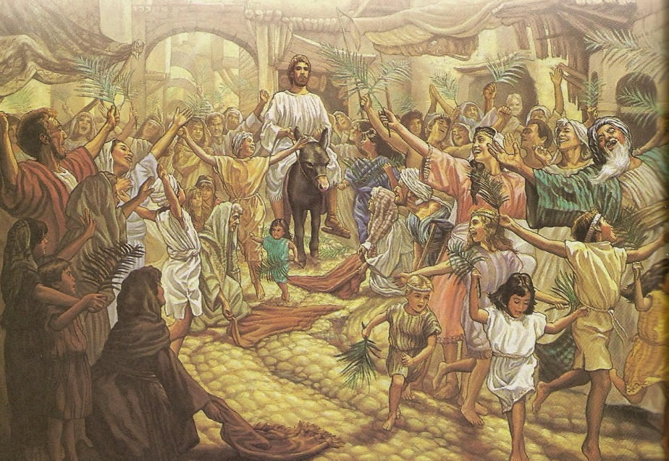
Matthew 21:10-11
And when he was come into Jerusalem, all the city was moved, saying, Who is this? ¹¹And the multitude said, This is Jesus the prophet of Nazareth of Galilee

Slide 82
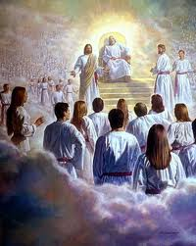
Acts 2:32-34
This Jesus hath God raised up, whereof we all are witnesses. ³³Therefore being by the right hand of God exalted, and having received of the Father the promise of the Holy Ghost, he hath shed forth this, which ye now see and hear. ³⁴For David is not ascended into the heavens: but he saith himself, The LORD said unto my Lord, Sit thou on my right hand.

Slide 83
Acts 5:31
Him hath God exalted with his right hand to be a Prince and a Saviour, for to give repentance to Israel, and forgiveness of sins.

Slide 84
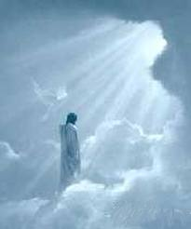
Acts 7:55-56
But he, being full of the Holy Ghost, looked up stedfastly into heaven, and saw the glory of God, and Jesus standing on the right hand of God, ⁵⁶And said, Behold, I see the heavens opened, and the Son of man standing on the right hand of God.

Slide 85
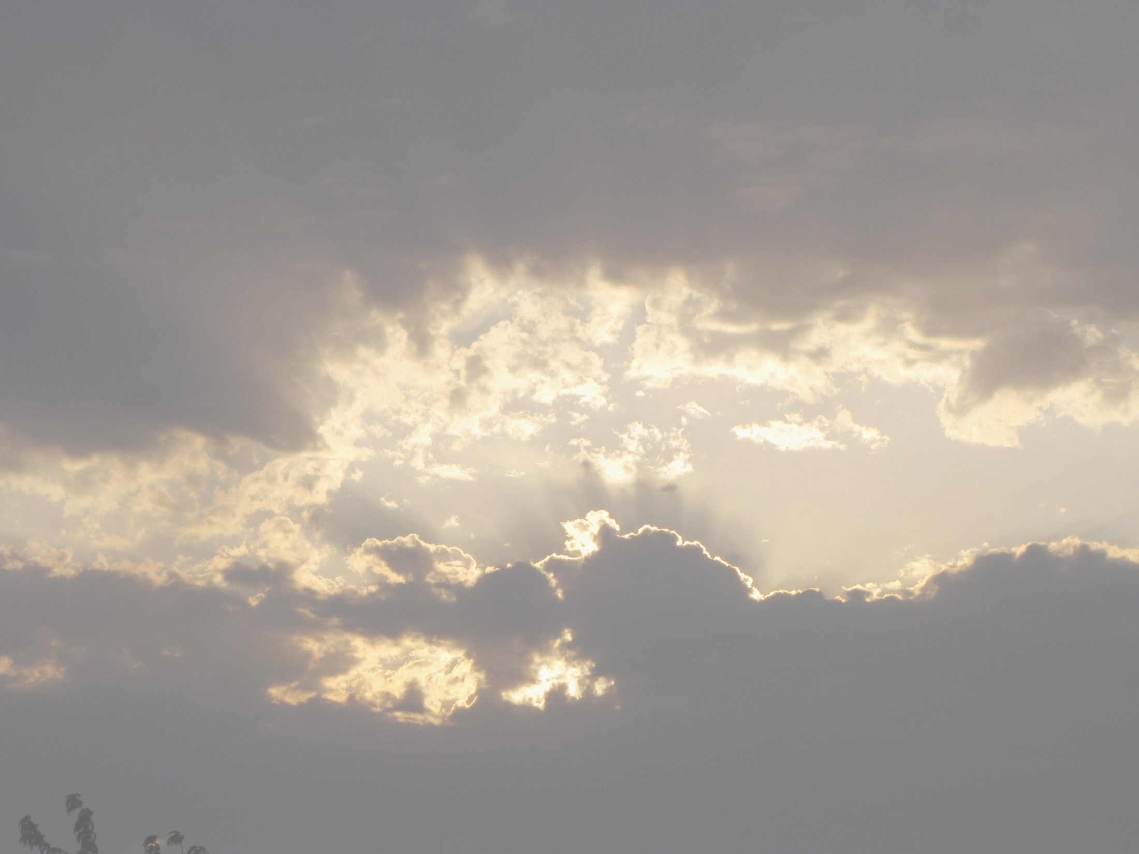
Romans 8:34
Who is he that condemneth? It is Christ that died, yea rather, that is risen again, who is even at the right hand of God, who also maketh intercession for us.

Slide 86
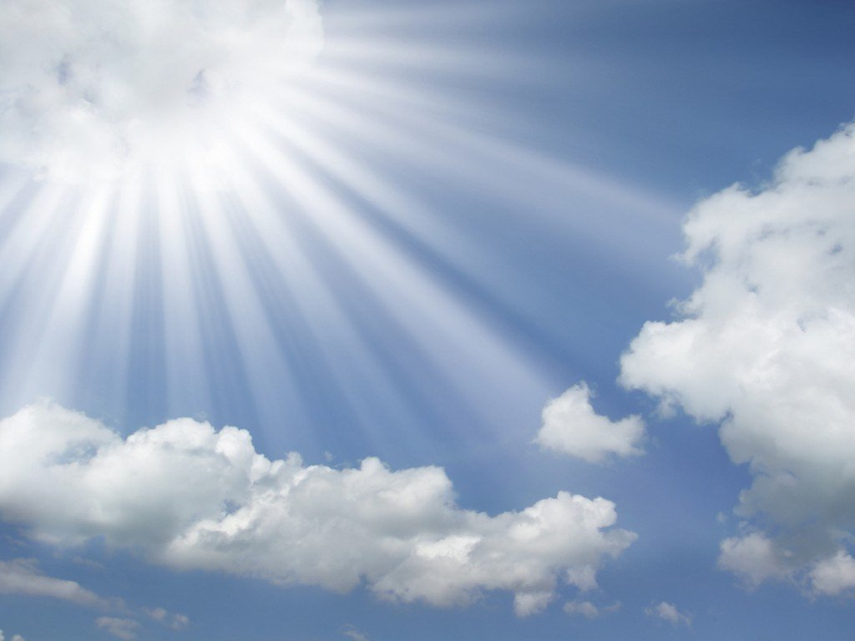
Ephesians 1:20-21
Which he wrought in Christ, when he raised him from the dead, and set him at his own right hand in the heavenly places, ²¹Far above all principality, and power, and might, and dominion, and every name that is named, not only in this world, but also in that which is to come.

Slide 87
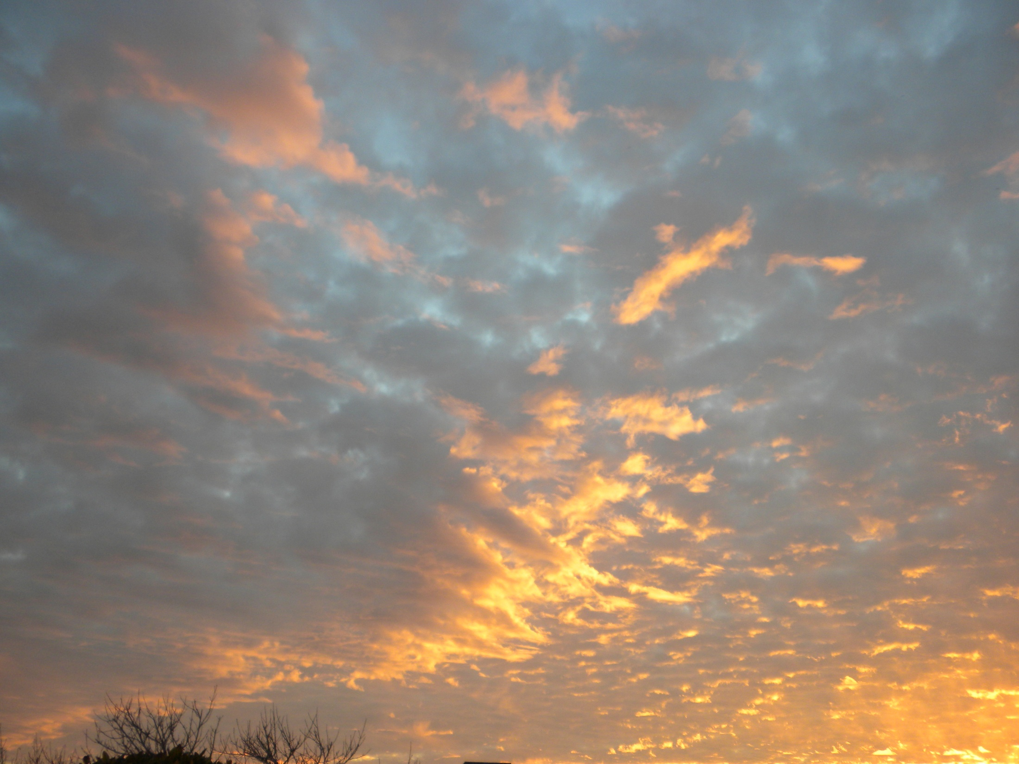
Colossians 3:1
If ye then be risen with Christ, seek those things which are above, where Christ sitteth on the right hand of God. ²Set your affection on things above, not on things on the earth.

Slide 88
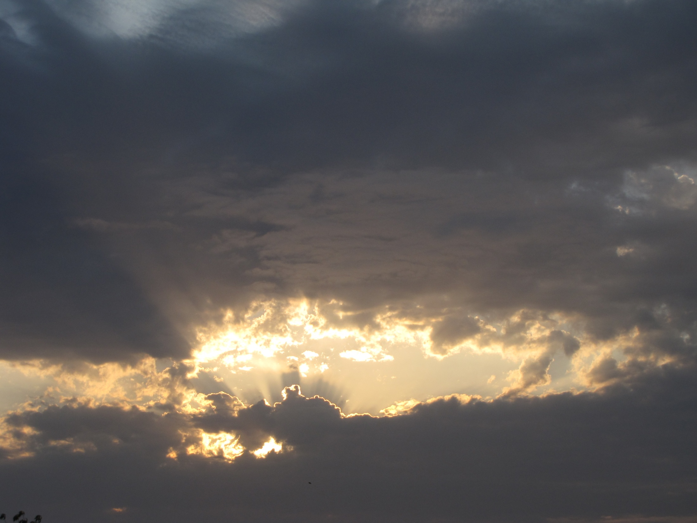
Hebrews 1:3
³Who being the brightness of his glory, and the express image of his person, and upholding all things by the word of his power, when he had by himself purged our sins, sat down on the right hand of the Majesty on high.

Slide 89
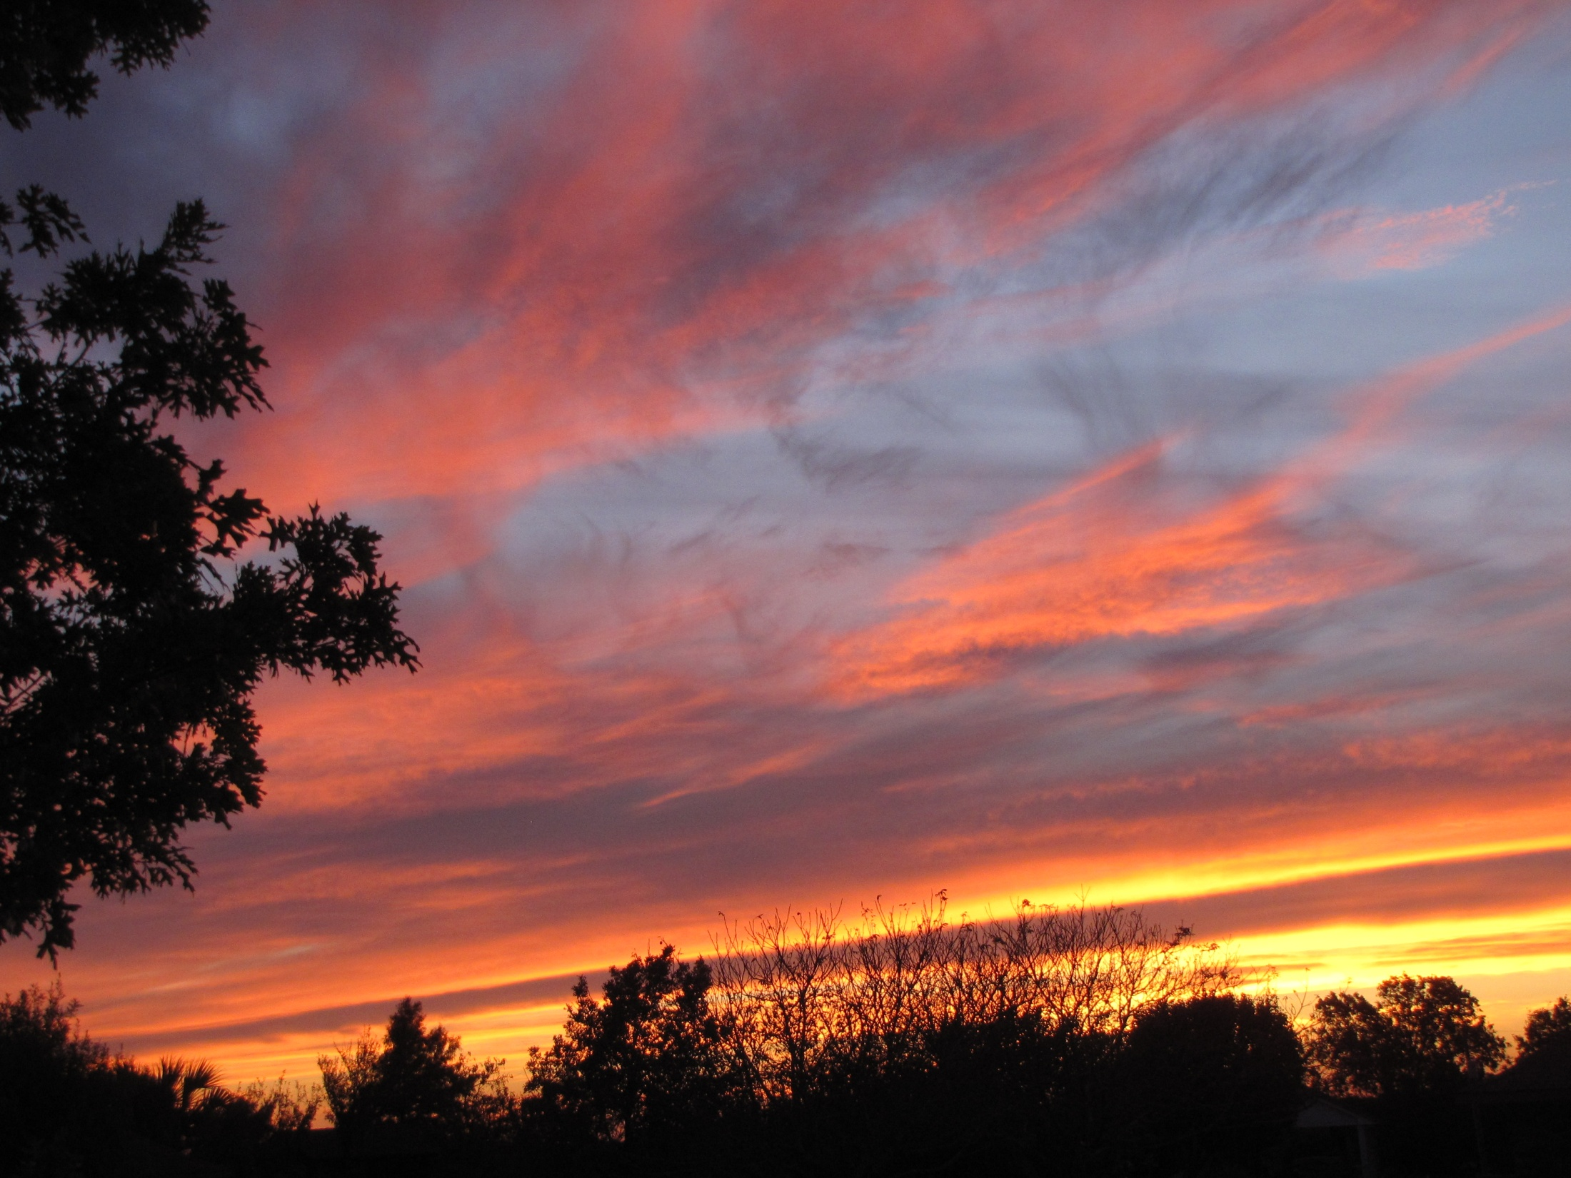
Hebrews 1:13-14
¹³But to which of the angels said he at any time, Sit on my right hand, until I make thine enemies thy footstool? ¹⁴Are they not all ministering spirits, sent forth to minister for them who shall be heirs of salvation.

Slide 90
Hebrews 8:1-2
¹Now of the things which we have spoken this is the sum: We have such an high priest, who is set on the right hand of the throne of the Majesty in the heavens; ²A minister of the sanctuary, and of the true tabernacle, which the Lord pitched, and not man.

Slide 91
Hebrews 10:12
But this man, after he had offered one sacrifice for sins for ever, sat down on the right hand of God.
Hebrews 12:2
Looking unto Jesus the author and finisher of our faith; who for the joy that was set before him endured the cross, despising the shame, and is set down at the right hand of the throne of God.

Slide 92
Hebrews 12:2
Looking unto Jesus the author and finisher of our faith; who for the joy that was set before him endured the cross, despising the shame, and is set down at the right hand of the throne of God.

Slide 93
1 Peter 3:21b-22
… Jesus Christ: ²²Who is gone into heaven, and is on the right hand of God; angels and authorities and powers being made subject unto him.

Slide 94
Revelation 1:17-18
¹⁷And when I saw him, I fell at his feet as dead. And he laid his right hand upon me, saying unto me, Fear not; I am the first and the last: ¹⁸ I am he that liveth, and was dead; and, behold, I am alive for evermore, Amen; and have the keys of hell and of death.

Slide 95
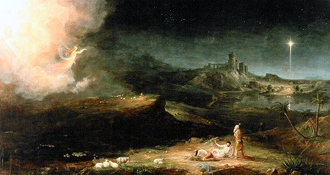
Luke 2:8-9
⁸And there were in the same country shepherds abiding in the field, keeping watch over their flock by night. ⁹And, lo, the angel of the Lord came upon them, and the glory of the Lord shone round about them: and they were sore afraid.

Slide 96
Luke 2:10-12
¹⁰And the angel said unto them, Fear not: for, behold, I bring you good tidings of great joy, which shall be to all people. ¹¹For unto you is born this day in the city of David a Saviour, which is Christ the Lord. ¹²And this shall be a sign unto you; Ye shall find the babe wrapped in swaddling clothes, lying in a manger.

Slide 97
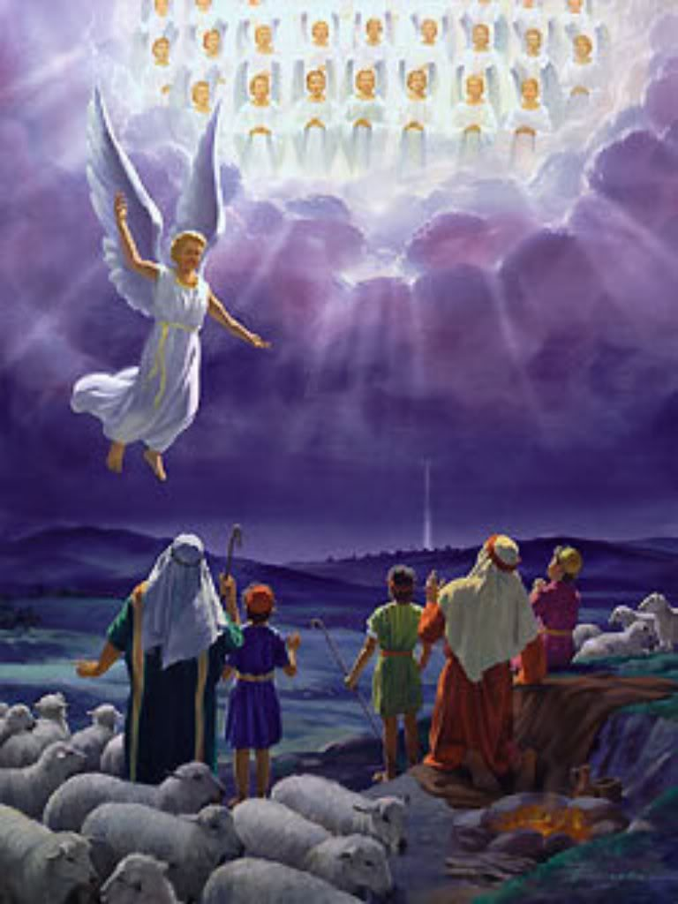
Luke 2:13-14
¹³And suddenly there was with the angel a multitude of the heavenly host praising God, and saying, ¹⁴Glory to God in the highest, and on earth peace, good will toward men.

Slide 98
What’s the Point?
Messiah Yeshua was born of a virgin where the sacrificial lambs were born and raised: Bethlehem (Migdol-Eder).
Messiah Jesus was crucified where the sacrificial lambs were sacrificed, Jerusalem.
The Sinless Lamb of God had entered His creation to take on Himself the penalty of death deserved by all mankind “for all have sinned and come short of the glory of God.”

Slide 99
Our Heavenly Father’s gift to us—eternal life through the death and resurrection of His only Son, the Messiah Lord Jesus.
“For the wages of sin is death; but the gift of God is eternal life through Jesus Christ our Lord.”
Romans 6:23

Slide 100
Romans 10:9-11
That if thou shalt confess with thy mouth the Lord Jesus, and shalt believe in thine heart that God hath raised him from the dead, thou shalt be saved. ¹⁰For with the heart man believeth unto righteousness; and with the mouth confession is made unto salvation. ¹¹For the scripture saith, Whosoever believeth on him shall not be ashamed.

Slide 101
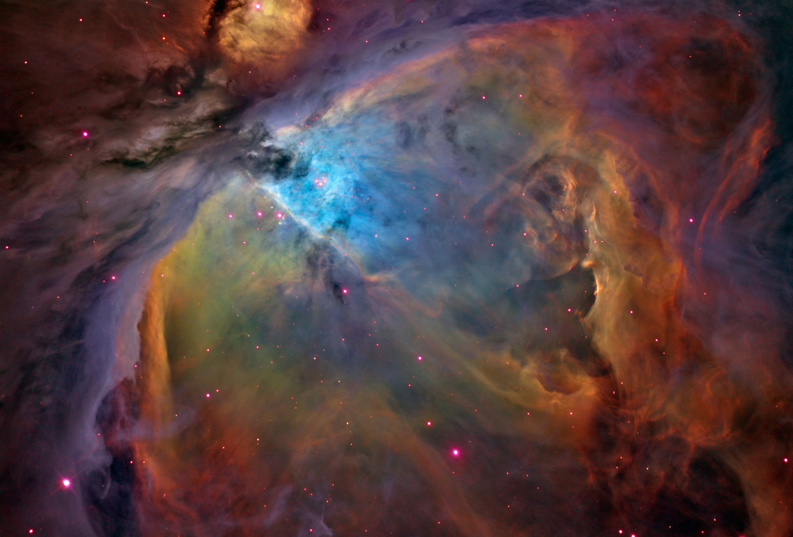
Revelation 5:11-12
And I beheld, and I heard the voice of many angels round about the throne and the beasts and the elders: and the number of them was ten thousand times ten thousand, and thousands of thousands; ¹²Saying with a loud voice, Worthy is the Lamb that was slain to receive power, and riches, and wisdom, and strength, and honour, and glory, and blessing.

Slide 102
Revelation 5:13-14
And every creature which is in heaven, and on the earth, and under the earth, and such as are in the sea, and all that are in them, heard I saying, Blessing, and honour, and glory, and power, be unto him that sitteth upon the throne, and unto the Lamb for ever and ever. ¹⁴And the four beasts said, Amen. And the four and twenty elders fell down and worshipped him that liveth for ever and ever.

Slide 103
That night when the angels came to the temple shepherds in the area of Migdol-Eder and proclaimed “For unto you is born this day in the city of David a Saviour, which is Christ the Lord,” was a night of all nights. It was a night to witness, a night to wonder and to worship!

Slide 105
Bibliography
Parts of this study came from the internet notes of Rabbi Mike L. Short about Migdol-Eder and from a devotional by Dr. Mark Bailey, President of Dallas Seminary presented at the 2011 meeting of the Pre-Trib Study Group.
The Scriptures cited are from the King James Version of the Bible.

