Slide 1

Speeding toward a Socialistic America
Dr.Jobe Martin
www.biblicaldiscipleship.org
www.creationproclaims.com
www.evolutionofacreationist.com
www.slideshare.net (Jobe Martin)

Slide 2
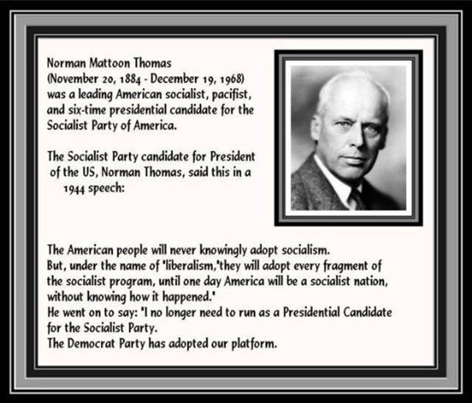

Slide 3
Speeding toward a socialist usa
Dr.Jobe Martin
www.biblicaldiscipleship.org
www.creationproclaims.com
www.evolutionofacreationist.com
www.slideshare.net (Jobe Martin)

Slide 4

Proverbs 14:12
There is a way which seemeth right unto a man, but the end thereof are the ways of death.

Slide 5
According to the Bible there will come someday a world order under one leader that will unify all religions into one, unify all economic systems into one and unify all political systems into a one world empire.

Slide 6
IN THE LAST DAYS THERE WILL BE:
A one world religious system
A one world economic system
A one world political system.

Slide 7
Revelation 13:8… RELIGION
⁸And all that dwell upon the earth shall worship him, whose names are not written in the book of life of the Lamb slain from the foundation of the world.

Slide 8
Revelation 13:16 Economics
¹⁶And he causeth all, both small and great, rich and poor, free and bond, to receive a mark in their right hand, or in their foreheads: ¹⁷And that no man might buy or sell, save he that had the mark, or the name of the beast, or the number of his name.

Slide 9
Revelation 13:7…Rule
⁷And it was given unto him to make war with the saints, and to overcome them: and power was given him over all kindreds, and tongues, and nations.

Slide 10
The Missing Pieces:
World Government
and
World Religion

Slide 11
What is restraining the globalists?
CHRISTIANS ARE THE ENEMY AND THE OBSTACLE TO THE NEW AGE/NEW WORLD SOCIALIST ORDER GOAL OF A WORLD GOVERNMENT, A WORLD RELIGION, AND A WORLD ECONOMIC SYSTEM!

Slide 12
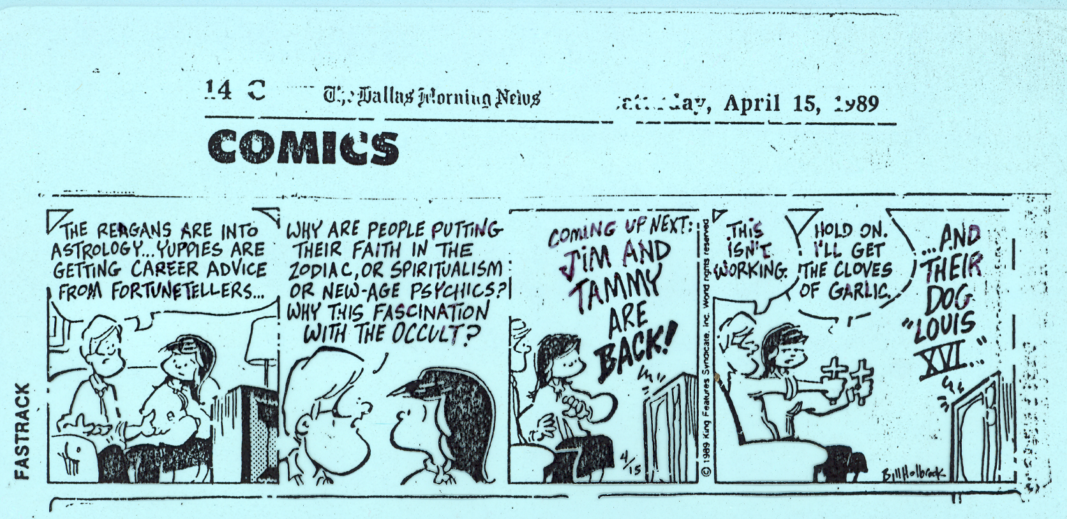

Slide 13


Slide 14


Slide 15
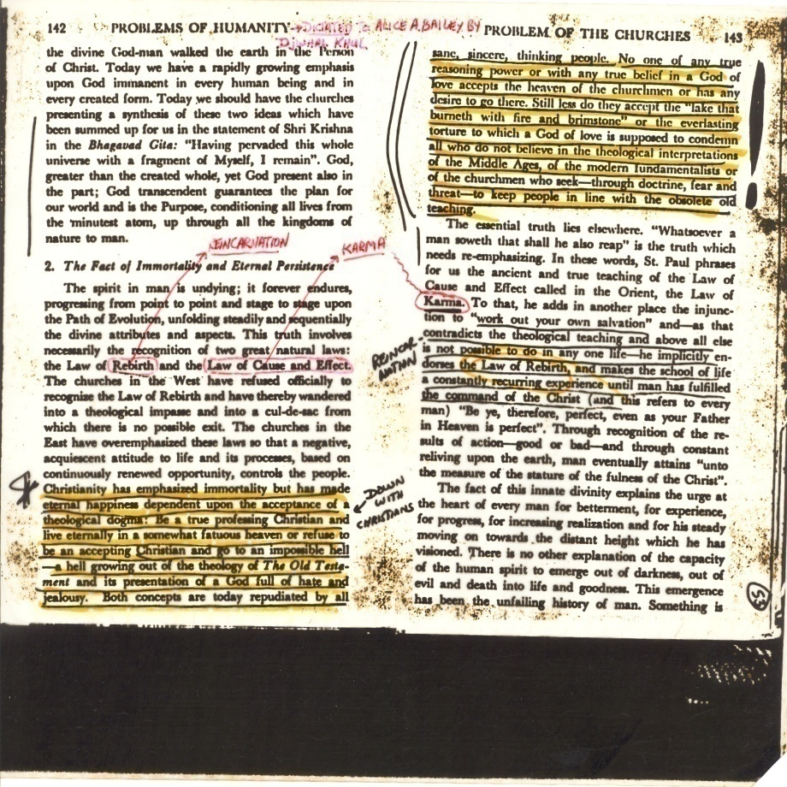

Slide 16
The Lord Jesus is in Control!!
All power is given unto Me in heaven and in earth. Go ye therefore, and teach all nations, baptizing them in the name of the Father, and of the Son, and of the Holy Ghost: Teaching them to observe all things whatsoever I have commanded you: and, lo, I am with you always, even to the end of the world. Amen. Matthew 28:19, 20

Slide 17
What about our schools?
“Education is the most powerful ally of Humanism, and every American school is a school of Humanism. What can the theistic Sunday Schools, meeting for an hour once a week, and teaching only a fraction of the children, do to stem the tide of a five-day program of humanistic teaching?” Charles Francis Potter
Humanism: A New Religion, (New York: Simon and Schuster), 1930, p. 16 Potter was a Unitarian minister, theologian and author who changed, over half a century, from an evangelical Baptist to a radical Humanist.

Slide 18
John Dunphy:
“A RELIGION FOR A NEW AGE”
“The battle for humankind’s future must be waged and won in the public school classroom by teachers who correctly perceive their role as the proselytizers of a new faith: a religion of humanity that recognizes and respects the spark of what theologians call divinity in every human being. . . .

Slide 19

These teachers must embody the same selfless dedication as the most rabid fundamentalist preachers, for they will be ministers of another sort, utilizing a classroom instead of a pulpit to convey humanist values in whatever subject they teach, regardless of the educational level—preschool day care or large state university.

Slide 20
The classroom must and will become an arena of conflict between the old and the new—the rotting corpse of Christianity, together with all its adjacent evils and misery, and the new faith of humanism, resplendent in its promise of a world in which the never realized Christian ideal of “love thy neighbor” will finally be achieved….humanism will emerge triumphant. It must if the family of humankind is to survive.” ~John Dunphy, The Humanist, (Jan. 1983, pp. 23-26)

Slide 21
Source: Nehemiah Institute. “PEERS Biblical Worldview Test.” Nehemiah Institute http://www.nehemiahinstitute.com/peers.php (accessed November 15, 2008)
Dan Smithwick, “Worldview Assessment and Training,” The Nehemiah Institute, www.nehemiahinstitute.com (accessed November, 14, 2008).

Slide 22
Figure 9. Christian “worldview” schools (<4% of youth), primarily Principle Approach and Classical Christian schools. Home School students also generally score in the 50-75 range. Traditional Christian schools (10-15% of youth). Public schools (80-85% of youth).
Source: Dan Smithwick, The Nehemiah Institute
Biblical Theism
C “W” S= 4%
Moderate Christian
T C S= 10-15%
Secular Humanism/Socialism
P S 80-85%

Slide 23
Biblical Theism
Biblical Theism, 70–100; Moderate Christian, 30–69; Secular Humanism 0–29; Pure Socialism, <0.
100-70
4%
Moderate Christianity
69-30
10-15%
80-85%
29-0
Secular Humanism/Socialism

Slide 24
This first category in the figure above is for Biblical Christianity. One can observe that over the twenty years the study represents, the trend has been away from the Christian worldview. The second category containing the percentages which are at or over 60%, is a reflection of youth who have been enrolled in schools that specifically train students in the Christian worldview. This is the only category that has maintained or shown positive growth over the period of the study

Slide 25
Dan Smithwick, of the Nehemiah Institute, summarizes the results of the institute’s testing in the following statement: “When over 90% of youth from Christian homes, either in public schools or in Christian schools, are moving away from a Biblical view of life, and closer to the Humanistic view of life, as documented by PEERS Testing, then clearly a disaster is in the making.”

Slide 26
The Making of a Disaster
70
Trend toward Secular Humanism and Socialism
30

Slide 27
NEA 2003 NEW ORLEANS
NEA CREATION SCIENCE EDUCATORS CAUCUS BOOTH
NEA MEMBERS COMMENTS:

Slide 28
NEA MEMBERS COMMENTS AS FREE CREATIONIST DVD’S GIVEN TO THEM WITH A WARM SMILE:
“Do you believe in gravity?”
“I don’t even know why you are here!”
Evolution has nothing to do with faith, it’s all fact!”
“You guys are crazy, you don’t belong here!”
“I’m so totally convinced of evolution- I’m tolerant of everything but what you believe!”

Slide 29
ANSWERS IN GENESIS DONATES ABOUT $50,000 OF FREE CREATION SCIENCE LITERATURE. NEA MEMBERS RESPONSES TO THESE FREE BOOKS AND CD’S:
“I don’t believe in faith.”
“I don’t need it thank you.”
“Out of your minds!”
“I’m a science teacher, you guys ought to get a life!”
“Go back to school and get an education.”

Slide 30
ARE THE TEACHERS OF THE NATIONAL EDUCATORS ASSOCIATION OPEN MINDED?
“Join the planet!”
“We’re educators, not magicians!”
“How asinine!”
“It’s impossible to refute the facts.” (But this teacher refused to take free information that refuted the macroevolutionary hypothesis.)

Slide 31
DELEGATES TO THE NEA SCORN THE BIBLICAL ACCOUNT OF CREATION:
“Get real!” (with an unkind gesture)
“There’s no question in my mind, creation is wrong.” (refused CD)
“You’re a threat to education.”
“Charles Darwin is my hero!”
“I teach science-no thanks, I have my religion!”
(YES, IT IS CALLED EVOLUTIONARY PHILOSOPHICAL NATURALISM)

Slide 32
“I HEARD YOU GUYS ARE LIKE THE TALIBAN, SO I HAD TO COME OVER HERE AND SEE FOR MYSELF!”
Proverbs 14:12
“There is a way which seemeth right unto a man, but the end thereof are the ways of death.”

Slide 33
By the way….

Slide 34
WHAT IS THE CHRISTIAN’S RESPONSE TO RIDICULE AND REJECTION?
“IF YE BE REPROACHED FOR THE NAME OF CHRIST, HAPPY ARE YE, FOR THE SPIRIT OF GLORY AND OF GOD RESTETH UPON YOU: ON THEIR PART HE IS EVIL SPOKEN OF, BUT ON YOUR PART HE IS GLORIFIED.”
I PETER 4:14

Slide 35

Luke 6:22-23
“Blessed are ye, when men shall hate you, and when they shall separate you from their company, and shall reproach you, and cast out your name as evil, for the Son of man’s sake. ²³Rejoice ye in that day, and leap for joy: for, behold, your reward is great in heaven….”

Slide 36
A SACRED TRUST AND RESPONSIBILITY FROM THE LORD
Prov. 22:6~ “Train up a child in the way he should go: and when he is old, he will not depart from it.”
Psalm 127; Children=“Assigned gift” of God (v.3)
Deut. 11:19~ And ye shall teach them your children, speaking of them when thou sittest in thine house, and when thou walkest by the way, when thou liest down, and when thou risest up.”
Deut. 4:9~“Only take heed to thyself, and keep thy soul diligently, lest thou forget the things which thine eyes have seen, and lest they depart from thy heart all the days of thy life: but teach them thy sons, and thy sons' sons.”
EVERYONE home schooled originally (Israelites did not send their children to the Canaanite Schools!)
Our children are taught Marxist Socialism from 1st G.

Slide 37

  According to the Bible there are two ways of walking through this life—the way of the righteous or the way of the wicked.
  The way of The Word or the way of the world.

Slide 38
This means that there are two basic, fundamental, foundational ways of thinking and doing on planet earth according to the Bible:
The two foundational ways of viewing life (worldviews) are:
1. Biblical Christianity
2. Satan’s world system

Slide 39

Included in Satan’s World System are all religious and philosophical ideas and practices that are not based solidly in Biblical Christianity and the sinless, crucified and bodily resurrected, only begotten Son of God, the Lord Jesus Christ.

Slide 40
John 3:16-18
For God so loved the world, that he gave his only begotten Son [Jesus], that whosoever believeth in him should not perish, but have everlasting life. ¹⁷For God sent not his Son into the world to condemn the world; but that the world through him might be saved. ¹⁸He that believeth on him is not condemned: but he that believeth not is condemned already, because he hath not believed in the name of the only begotten Son of God.

Slide 41
This means that there are two basic, fundamental, foundational ways of thinking and doing on planet earth according to the Bible:
The two foundational ways of viewing life (worldviews) are:
1. Biblical Christianity
2. Satan’s world system

Slide 42
WHAT IS A WORLDVIEW?
Your worldview is your basic belief system.
Your worldview is the position you take regarding the answers to the major questions in life such as:
Does God exist and is He Good?
What can be known for sure?
Who am I; why am I here; where am I going?
What do I value; what is important to me?
Is there purpose and direction to life?

Slide 43


Slide 44
Behavior
Values
Respect for life
Wealth
Truth
“Fruit of the Spirit”
Happiness
Health
Loyalty
www.summit.org
Summit Ministries
Manitou Spgs. CO
Worldview
A set of beliefs or ideas / a system of thought
Theology
Philosophy
Ethics
Biology
Psychology
Law
Sociology
Politics
Economics
History
“For as he thinketh in his heart, so is he.” Proverbs 23:7

Slide 45
What are some of the anti-Biblical worldviews promoted by the god of this world, Satan, that are popular on the campuses of the world and appear to be attracting up to 89% of our kids?

Slide 46
Summit.org | Secular Humanism | Marxism/ Leninism | Cosmic Humanism | Biblical Christianity
Sources: | Humanist Manifestos I, II | Writings of Marx and Lenin | New Age writers: Ferguson, Bailey | Bible
Theology | Atheism | Atheism | Pantheism | Theism
Philosophy | Naturalism | Dialectical Materialism | Non-Naturalism | Supernaturalism
Ethics | Relativism | Proletariat Morality | Relativism | Absolutes
Biology | Evolution | Evolution | Evolution | CREATION
Psychology | Self-actualization | Behaviorism | Collective Consciousness | Mind-Body Dualism
Sociology | Non-Traditional Family | Abolition of Home Church and State | Non-Tradition Home Church and State | Traditional Home Church State
Law | Positive Law | Positive Law | Self-Law | Biblical Law
Politics | World Gov. (Globalism) | New World Order | New Age Order | Justice, Freedom Order
Economics | Socialism | Socialism | Enlightened Production | Stewardship Private Prop.
History | Historical Evolution | Historical Materialism | Evolutionary Godhood | Historical Resurrection
Postmod
Islam

Slide 47

Psalm 1:6
For the LORD knoweth the way of the righteous: but the way of the ungodly shall perish.

Slide 48

According to the Bible the way of the Righteous is narrow, but the way of the wicked is broad!
“Enter ye in at the strait [narrow] gate: for wide is the gate, and broad is the way, that leadeth to destruction, and many there be which go in thereat.” Matt. 7:13

Slide 49
According to the Bible, the “broad way” that leads to destruction is composed of
The Cults
Hinduism
Buddhism
Humanism
Marxism
Atheism
Islamism
Postmodernism
New Age-Cosmic Humanism
Communism
Shintoism
Agnosticism,
Judaism, etc…
All of the above reject the crucified and resurrected Messiah Yeshua, Lord Jesus Christ, therefore they are on the Broad Way.

Slide 50
Those on the Broad Way hate the Bible and want to destroy the Truth of the Bible, its principles, its Gospel and its saved Believers (saved by faith in the shed blood, death and resurrection of God the Son, the Lord Jesus Christ).

Slide 51

John 15:18 Jesus said, ‘If the world hate you, ye know that it hated me before it hated you.’

Slide 52
1 John 5:12-13
“He that hath the Son hath life; and he that hath not the Son of God hath not life. ¹³These things have I written unto you that believe on the name of the Son of God; that ye may know that ye have eternal life, and that ye may believe on the name of the Son of God.”

Slide 53
John 14:6
“Jesus saith unto him, ‘I am the way, the truth, and the life: no man cometh unto the Father, but by me.’”
True Biblical Christianity is absolutely exclusive—but it is extended to all people because it is God’s will that everyone should come to repentance so that no one will forever perish. 2 Peter 3:9

Slide 54
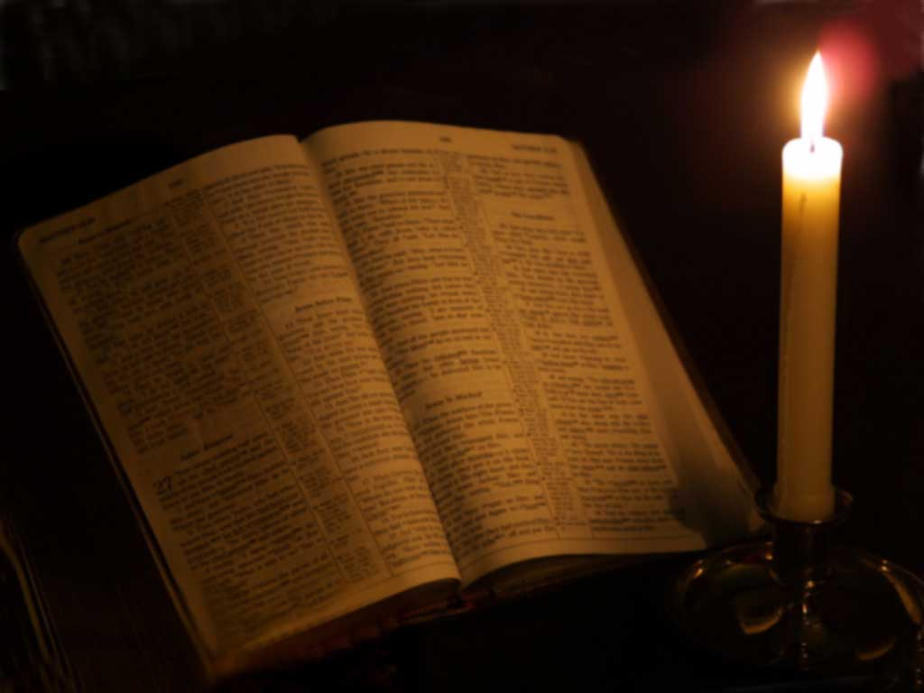
How might the Christianity of the western world be compromised and neutralized?

Slide 55
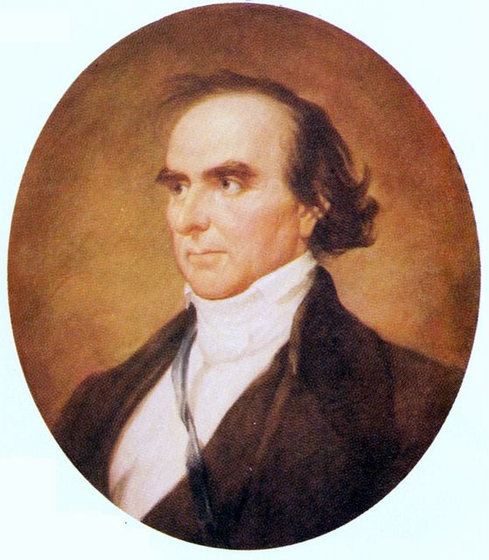
Daniel Webster, 1823
“If truth be not diffused, error will be; if God and His word are not known and received, the devil and his works will gain ascendancy”

Slide 56

What is the plan?
What appears to be the major parts of the devil’s plan to destroy Western Christianity and gain ascendancy in the free world?

Slide 57

What is the plan?
One part of the devil’s plan is to destroy the authority of the Bible by getting rid of Jesus and calling the early chapters of Genesis a poetical story, allegory, symbol, or myth.

Slide 58
THE FOUNDATIONAL BATTLE OF CREATION VS EVOLUTION IS REALLY THE BATTLE FOR THE GOSPEL.
G. Richard Bozarth writes (“The Meaning of Evolution,” American Atheist, Sept. 20, 1979, p. 30):
“Christianity has fought, still fights, and will fight science to the desperate end over evolution because evolution destroys utterly and finally the very reason Jesus’ earthly life was supposedly made necessary. Destroy Adam and Eve and the original sin, and in the rubble you will find the sorry remains of the [S]on of [G]od.

Slide 59
If Jesus was not the [R]edeemer that died for our sins, and this is what evolution means, then Christianity is nothing.”
~G. Richard Bozarth
Atheist Bozarth understands this issue much better than the average Christian!

Slide 60
If Genesis is not true history then Jesus is not the Creator.
If Jesus is not the Creator then He would not have the authority or the right to be the Savior.
If Jesus is not the Savior, then He cannot be the righteous Judge of mankind.
If Jesus is not the Judge, then there is no Judge and whoever has the most power rules!
If whoever has the most power rules a two class society results=the elites and the slaves!

Slide 61


Slide 62
Abraham Lincoln said this:
“You cannot help the poor by destroying the rich.
You cannot strengthen the weak by weakening the strong.
You cannot bring about prosperity by discouraging thrift.
You cannot lift the wage earner up by pulling the wage payer down.
You cannot further the brotherhood of man by inciting class hatred.

Slide 63
Abraham Lincoln said this:
You cannot build character and courage by taking away people’s initiative and independence.
You cannot help people permanently by doing for them what they could and should do for themselves.”
It is obvious that Abraham Lincoln understood the evils of a socialistic system!
Notes:
tem

Slide 64
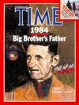
George Orwell: “Those who control language and manipulate key phrases can control policy.”

Slide 65
POSTMODERNISTS CLAIM:
There are no “truths” which apply to all of us.
There are no absolute moral standards.
There are no absolute ethical concerns.
There is no God.
There are personal opinions.
There are personal perspectives.
See the writings of Nietzsche, Derrida, Lyotard, Ricouer, Foucault, Rorty, Baudrillard, etc.
Most Postmodernist thinkers are/were disillusioned Marxists.

Slide 66
MARXISTS AND POSTMODERNISTS ARE ATHEISTS.
“Atheism is the theological belief that there is no God, no supernatural Creator, no Divine moral law giver, and no ultimate Judge of man’s actions. It is the theological backbone of not only Secular Humanism and Marxism, but it is also the predominant theological view of classical Postmodernism” (David Noebel, Understanding the Times, p. 77).

Slide 67
POSTMODERNIST
RICHARD RORTY:
“I might have written an account of how even atheists like myself are impressed, improved and morally instructed by reading Pilgrim’s Progress.”

Slide 68
ROMANS 1:19-22
19 Because that which may be known of God is manifest in them; for God hath shewed it unto them. 20 For the invisible things of him from the creation of the world are clearly seen, being understood by the things that are made, even his eternal power and Godhead; so that they are without excuse: 21 Because that, when they knew God, they glorified him not as God, neither were thankful; but became vain in their imaginations, and their foolish heart was darkened. 22 Professing themselves to be wise, they became fools, …

Slide 69
Disillusioned Marxists became PostModernists and now gain strength through Multiculturalism and its stepchild, Political Correctness, which is rightly labeled, “Cultural Marxism”.
Marx and Lenin taught that, given the chance, European workers would overthrow capitalist governments and replace them with communism.
But after the Russian revolution of 1917 the Western European workers did not support the Communist revolution or ideas.
Why not?

Slide 70
Christianity and its moral and ethical absolutes was the roadblock to the expansion of Marxism.
This roadblock was noticed by two Marxist theorists in 1919: Italian, Antonio Gramsci and Hungarian, Georg Lukacs.
These two men decided that the spread of Communism could only be accomplished if Western Christian culture was destroyed.
So Lukacs introduced sex education into the public schools of Hungary,1919, believing that if children knew more about s-x their lust for it would overpower their Christian morals!

Slide 71
So Gramsci and Lukacs laid the groundwork to change communism from economic terms (ownership of private property is evil) into cultural terms. (tolerance, sex ed, drug ed, etc.)
Then in 1923 at Frankfurt University in Germany the Institute for Social Research was established=The Frankfurt School.
The Frankfurt School moved to New York City in 1933 when Hitler came to power.
Theorists like Wilhelm Reich, Eric Fromm, Max Horkheimer, Herbert Marcuse, etc.

Slide 72
The Frankfurt School invented “Critical Theory” which had the goal of demonizing all traditional institutions such as family, fatherhood, patriotism, Bible-believing churches, Capitalism, etc.
The Frankfurt School published “Studies in Prejudice” which taught that anyone who believes in traditional Western Christian culture is prejudiced, a “racist” or “sexist” or “fascist” or is mentally unstable.
Mixing Freud with Marx, they perfected the technique of psychological conditioning—thus, for example, TV displays Homosexuals=normal.
TV=Christians are crazy, intolerant, bigoted fools

Slide 73
Herbert Marcuse, working with Hollywood friends, became a leading “evangelist” of Cultural Marxism (Political Correctness) especially on the university campuses of USA.
“In his book Eros and Civilization, he argued that by freeing s-x from any restraints, we could elevate the pleasure principle over the reality principle and create a society with no work, only play (Marcuse coined the phrase, “Make love, not war”). Marcuse also argued for what he called “liberating tolerance,” which he defined as tolerance for all ideas coming from the Left and intolerance for any ideas coming from the

Slide 74
right. In the late 1960’s Marcuse became the chief “guru” of the New Left, and he injected the cultural Marxism of the Frankfurt School into the baby boom generation, to the point where it is now America’s state ideology.
The next conservatism should unmask multicul- turalism and Political Correctness and tell the American people what they really are: cultural Marxism. Its goal remains that Lukacs and Gramsci set in 1919: destroying Western culture and the Christian religion. [see: Wm. Lind, “Cultural Marxism” The Schwarz Report, vol. 46, No. 4, p 4. www.schwarzreport.org]

Slide 75
PSALM 19:7-9
The law of the Lord is perfect, converting the soul; the testimony of the Lord is sure, making wise the simple.
The statutes of the Lord are right, rejoicing the heart; the commandment of the Lord is pure enlightening the eyes.
The fear of the Lord is clean, enduring forever; the judgments of the Lord are true and righteous altogether.

Slide 76
Jeremiah 20:10-11
“But the LORD is with me as a mighty terrible one: therefore my persecutors shall stumble, and they shall not prevail: they shall be greatly ashamed; for they shall not prosper: their everlasting confusion shall never be forgotten.”

Slide 77
WE DON’T KNOW OUR HISTORY
Since 1859: Darwinian Evolution----Feminism----Humanistic Psychology---Socialistic Public Education and Organized Sports; all destructive of freedom.
John Dewey, a founder of the modern public school system, said, "Children who know how to think for themselves spoil the harmony of the collective society which is coming where everyone is interdependent.” http://quotes.liberty-tree.ca/quote_blog/John.Dewey.Quote.579A

Slide 78
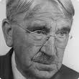
WE DON’T KNOW OUR HISTORY
Dewey's philosophy was called instrumentalism (related to pragmatism—what is practical).
Instrumentalism believes that truth is an instrument used by human beings to solve their problems.
Since problems change, then so must truth.
Since problems change, truth changes, and therefore there can be no eternal reality.
No eternal reality=Bible is words of men.
If the Bible is the words of men then let us eat, drink and be merry for tomorrow we die.

Slide 79
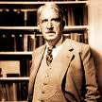
John Dewey
“Give the pupils something to do, not something to learn; and the doing is of such a nature as to demand thinking; learning naturally results.”
“Genuine ignorance is profitable because it is likely to be accompanied by humility, curiosity, and open mindedness; whereas ability to repeat catch-phrases,… familiar propositions, gives the conceit of learning and coats the mind with varnish waterproof to new ideas.” http://wilderdom.com/experiential/JohnDeweyQuotes.html

Slide 80
Tom DeWeese: “Rather than good management of resources, Sustainable Development has come to mean denied use and resources locked away from human hands. In short, it has become a code word for an entire economic and social agenda.”
This agenda is foundational to all government education.

Slide 81
By the way:

Slide 82

Nowhere is safe!
Our safety is in
our Lord Jesus!

Slide 83
Source: Nehemiah Institute. “PEERS Biblical Worldview Test.” Nehemiah Institute http://www.nehemiahinstitute.com/peers.php (accessed November 15, 2008)
Dan Smithwick, “Worldview Assessment and Training,” The Nehemiah Institute, www.nehemiahinstitute.com (accessed November, 14, 2008).

Slide 84
Figure 9. Christian “worldview” schools (<4% of youth), primarily Principle Approach and Classical Christian schools. Home School students also generally score in the 50-75 range. Traditional Christian schools (10-15% of youth). Public schools (80-85% of youth).
Source: Dan Smithwick, The Nehemiah Institute
Biblical Theism
C “W” S= 4%
Moderate Christian
T C S= 10-15%
Secular Humanism/Socialism
P S 80-85%

Slide 85
Biblical Theism
Biblical Theism, 70–100; Moderate Christian, 30–69; Secular Humanism 0–29; Pure Socialism, <0.
100-70
4%
Moderate Christianity
69-30
10-15%
80-85%
29-0
Secular Humanism/Socialism

Slide 86
This first category in the figure above is for Biblical Christianity. One can observe that over the twenty years the study represents, the trend has been away from the Christian worldview. The second category containing the percentages which are at or over 60%, is a reflection of youth who have been enrolled in schools that specifically train students in the Christian worldview. This is the only category that has maintained or shown positive growth over the period of the study

Slide 87
Dan Smithwick, of the Nehemiah Institute, summarizes the results of the institute’s testing in the following statement: “When over 90% of youth from Christian homes, either in public schools or in Christian schools, are moving away from a Biblical view of life, and closer to the Humanistic view of life, as documented by PEERS Testing, then clearly a disaster is in the making.”

Slide 88
The Making of a Disaster
70
Trend toward Secular Humanism and Socialism
30

Slide 89
This chart has “Christian” high school students from public, traditional Christian, and classical, worldview and home schools.
Results from among these schools show a rapid decline in beliefs based on the Christian worldview and a movement toward Secular Humanism. Score Range: Biblical Theism, 70–100; Moderate Christian, 30–69; Secular Humanism 0–29; Socialism, <0.

Slide 90
The PEERS test consists of a series of statements carefully structured to identify a person's worldview in five categories: Politics, Economics, Education, Religion, and Social Issues (PEERS). Each statement is framed to either agree or disagree with a biblical principle.
This shows summary results of PEERS testing since 1988. PEERS testing of public school students was achieved primarily by testing youth groups in Evangelical churches where most students attend public schools.

Slide 91
The Making of a Disaster
70
Trend toward Secular Humanism and Socialism
30

Slide 92
THE VALUES OF U.S. 18-25 Yr. OLDS:
81% say getting rich most important goal in life
51% say becoming famous most important goal
30% say helping people in need is a goal
22% say goal of becoming a community leader
Only 10% say goal is to become more spiritual

Slide 93


So what is the goal of most of today’s younger generation in USA? They want to become rich and famous!

Slide 94


ALREADY GONE by Ken Ham and Britt Beemer
Only 20% churched as a teen are spiritually active at age 29
61% churched as teen, disengaged during twenties

Slide 95
Of all the 20 to 29-year-old evangelicals who attended church regularly but no longer do so:
95% of them attended church regularly during their elementary and middle school years
55% attended church regularly during high school
11% were still attending church during college.
Already Gone, p.31

Slide 96
We are losing 40% before high school.
We are losing another 44% before college.

Slide 97
ACCORDING TO JOSH McDOWELL:
We are witnessing “The Last Christian Generation.”
Only 1/3 of “church-going” teenagers say the church will play a role in their future lives.
According to pollster George Barna: 63% of teens do not believe Jesus is God’s Son.
60% believe all faiths teach equally valid truths.
51% do not believe Jesus rose from the dead.
66% do not believe Satan or the Holy Spirit exist.

Slide 98

93% of all youth have lied to a parent.
75% of Christian and non-Christian youth have cheated on a test.
66% of all youth have physically hurt someone.
70% of churched teens believe there is no absolute moral truth.
[This is called “Moral Relativism.”]
Barna research reports: 98% of professed born-again youth “…do believe in Christ, but they do not reflect Christ-like attitudes or actions.”
Does Satan believe in Christ?

Slide 99

In other words, there is a “disconnect” between “knowing Truth” and “practicing Truth.”
John 3:21:
“But he that doeth truth cometh to the light, that his deeds may be made manifest, that they are wrought in God.”

Slide 100

WE ARE LOSING 57%-89% OF “CHRISTIAN” YOUTH by AGE 22!
(published figures)
Friends with Campus Crusade for Christ tell me, “If we don’t get the Christian kids within the first six weeks of their freshman year [of college], we’ve lost them to the competing worldviews.”
How do we lose them?

Slide 101
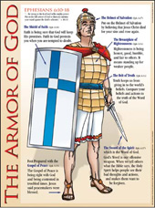

We are not teaching our children how to defend our faith and the necessity of defending it!

Slide 102
We need to form an agenda, a plan, a well defined BIBLICAL purpose for our children.
The enemy knows exactly what they want to accomplish and they are accomplishing their objective of ripping our children away from their Christian roots AND making them into committed humanist/marxist socialists.
89% have accepted other worldviews by age 22!

Slide 103

POSTMODERNIST RICHARD RORTY:
“I might have written an account of how even atheists like myself are impressed, improved and morally instructed by reading Pilgrim’s Progress.”

Slide 104
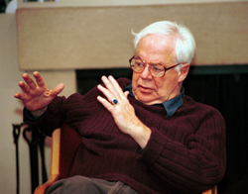
Postmodernist Professor Richard Rorty as quoted in World magazine September, 2008:
“The fundamentalist parents of our fundamentalist students think that the entire ‘American liberal establishment’ is engaged in a conspiracy….The parents have a point. Their point is that we liberal teachers no more feel in a symmetrical communication situation when we talk with bigots than do kindergarten teachers talking with their students.”

Slide 105

Rorty said to parents:
“We are going to go right on trying to discredit you in the eyes of your children, trying to strip your fundamentalist religious community of dignity, trying to make your views seem silly rather than discussable.”

Slide 106
Rorty said to parents:
“I think those students are lucky to find themselves under…people like me, and to have escaped the grip of their frightening, vicious, dangerous parents.”
“Not all university professors are so contemptuous of students, parents , and religious belief, but quite a few share Rorty’s attitude. Most students at secular colleges and universities will have to to deal with professors like this.”
World, p. 31

Slide 107
Proverbs 14:12
“There is a way which seemeth right unto a man, but the end thereof are the ways of death.”

Slide 108


Another major strategy is called “Sustainable Development.”

Slide 109
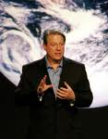
SUSTAINABLE DEVELOPMENT
In his book, Earth in the Balance, Al Gore warned that a “wrenching transformation” must take place to lead America away from the “horrors of the Industrial Revolution.” The process to do that is called Sustainable Development and its roots can be traced back to a UN policy document called Agenda 21, adopted at the UN’s Earth Summit in 1992.
(See: www.americanpolicy.org)

Slide 110
1 Timothy 1:19-2:6
“Holding faith, and a good conscience; which some having put away concerning faith have made shipwreck: ²⁰Of whom is Hymenaeus and Alexander; whom I have delivered unto Satan, that they may learn not to blaspheme. ^{2:1}I exhort therefore, that, first of all, supplications, prayers, intercessions, and giving of thanks, be made for all men.”

Slide 111
1 Timothy 1:19-2:6
“For kings, and for all that are in authority; that we may lead a quiet and peaceable life in all godliness and honesty. ³For this is good and acceptable in the sight of God our Saviour; ⁴Who will have all men to be saved, and to come unto the knowledge of the truth. ⁵For there is one God, and one mediator between God and men, the man Christ Jesus; ⁶Who gave himself a ransom for all, to be testified in due time.”

Slide 112
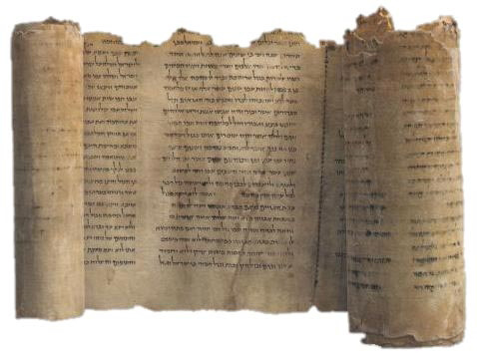
Remember:
The Old and New Testament prophets did not hesitate to warn God’s people about the demonic deceptions of their day!

Slide 113
“Many Americans appear to be awakening from their slumber of apathy as government forces are making their move for total control of our lives [This is Marxist Socialism]. Massive TEA Party protests across the country show a growing movement of concerned, dedicated Americans. But there is a major component missing from those protests. There is a nearly universal lack of understanding of the issue of Sustainable Development and the dangers it poses to our liberty. Consequently that issue is being left out of the protests.” Tom DeWeese, Special Report

Slide 114

AMERICA: WE FACE A DIABOLICAL AGENDA OF TOTAL CONTROL!!
This control is being engineered by a group of officials in our USA who do not share our values of freedom, liberty and justice for all.

Slide 115

Included in the Sustainable Development agenda of total control is:
Cap N Trade
Climate Change Global Warming
Population Control
Gun Control
Open Borders/
Illegal Immigration
Higher Taxes

Slide 116



Included in the Sustainable Development agenda of total control
Higher Gas Prices
Refusal to drill American oil
Education Restructuring
International IDs
Health Food Supplement Control
Food Control
Farming Reform
Control of Private Property
UN Global Governance

Slide 117
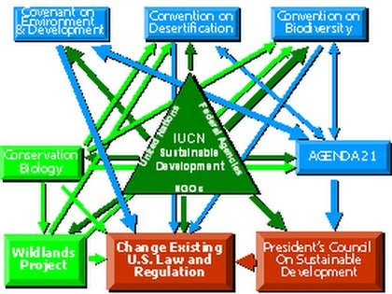
All of these areas listed above are included one way or another in the UN Agenda 21 Blueprint for Sustainable Development.

Slide 118

America,
our God-given and constitutional freedoms are being ripped right out from under us.
The Marxist-Socialists are destroying our Constitutional Republic and despising our Biblically-based value system.

Slide 119

Romans 13:1-3
“Let every soul be subject unto the higher powers. For there is no power but of God: the powers that be are ordained of God. ²Whosoever therefore resisteth the power, resisteth the ordinance of God: and they that resist shall receive to themselves damnation. ³For rulers are not a terror to good works, but to the evil. Wilt thou then not be afraid of the power? do that which is good, and thou shalt have praise of the same.”

Slide 120
Romans 13:4-6
“For he is the minister of God to thee for good. But if thou do that which is evil, be afraid; for he beareth not the sword in vain: for he is the minister of God, a revenger to execute wrath upon him that doeth evil. ⁵Wherefore ye must needs be subject, not only for wrath, but also for conscience sake. ⁶For for this cause pay ye tribute also: for they are God’s ministers, attending continually upon this very thing.”

Slide 121
Romans 13:7-10
“Render therefore to all their dues: tribute to whom tribute is due; custom to whom custom; fear to whom fear; honour to whom honour. ⁸Owe no man any thing, but to love one another: for he that loveth another hath fulfilled the law. ⁹For this, Thou shalt not commit adultery, Thou shalt not kill, Thou shalt not steal, Thou shalt not bear false witness, Thou shalt not covet; and if there be any other commandment, it is briefly comprehended in this saying, namely, Thou shalt love thy neighbour as thyself. ¹⁰Love worketh no ill to his neighbour: therefore love is the fulfilling of the law.”

Slide 122
We submit to the rule of the elected leaders of USA, but if they support and make laws that are unbiblical—
We Vote Them Out Of Office!
This is our right and our duty before our God!!!!

Slide 123
If we cannot seem to vote them or their ungodly ideas out of the leadership of our country we must stand up in the marketplace and insist on Godly standards for our country and our people. In doing so we may be subject to the rage of the government. No matter what the cost, the circumstance or the consequence we must practice God’s Truth and contend for the faith!

Slide 124
SUSTAINABLE DEVELOPMENT
Sustainable Development calls for changing the very infrastructure of the nation, away from Biblical values, private ownership and private control of property to nothing short of central planning of the entire economy—often referred to as top-down control. Sustainable Development is designed to fundamentally change our way of life and destroy our control of family, our freedom of religion, and the sovereignty of our nation.

Slide 125
SUSTAINABLE DEVELOPMENT
Sustainable Development is the surreptitious method that Big Government is using to redistribute our wealth to folks who did not earn it, but will be a guaranteed vote for the politician who “redistributes” it to them.
Socialism thrives on governments stealing from the rich to give to the poor—this is “redistribution” of wealth. Another name for this diabolical practice is Sustainable Development.

Slide 126
Slogans of “Sustainable Development” are such words and phrases as:
  Community Development
  Historic Preservation
  “Partnerships” between government and private business.
  Social Justice
  “Facilitators” outline a “vision” for a community enforced by “consensus.”
  Protection of our Environment
  These are all part of the strategy of Marxist Socialists who now are in leadership in our country!

Slide 127
Slogans of “Sustainable Development” are such words and phrases as:
Free Trade
Social Justice
Consensus
Global Truth
Partnerships
Preservation
Stakeholders
Land Use
Environmental Protection
Development
Diversity
Visioning
Open Space
Heritage
Comprehensive Planning
Critical Thinking
Community Service
Volunteerism

Slide 128



Sustainablist policy focuses on three components:
1) Global Land Use
2) Global Education
3) Global Population Control

Slide 129
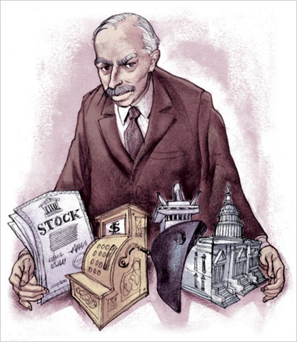
THE MARXIST-SOCIALIST AGENDA OF SUSTAINABLE DEVELOPMENT IS SUPPORTED AND ENABLED BY KEYNESIAN ECONOMICS WHICH ENABLES GLOBAL POPULATION CONTROL.

Slide 130

John Maynard Keynes, The Economic Consequences of the Peace, pp. 235, 236
“By a continuing process of inflation, governments can confiscate, secretly and unobserved, an important part of the wealth of their citizens. There is no subtler, no surer means of over-turning the existing basis of a society than to debauch its currency.

Slide 131

Keynes, continues:
The process engages all the hidden forces of economic law on the side of destruction, and it does so in a manner which not one man in a million is able to diagnose.”
Quoted by the McAlvany Intelligence Advisor, Sept. 2010

Slide 132
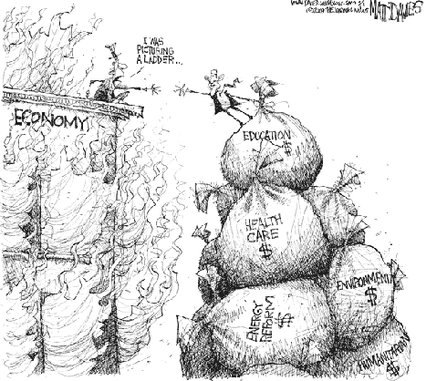
Ultimately Keynsian economics results in Hyperinflation!

Slide 133
The EIGHT Deadly Signs on the Way to Hyperinflation:
1. The moral erosion that results when a nation prioritizes greed and pleasure above Biblical Principles.
2. The creation of a Fiat Currency System.
3. Price distortion resulting from the easy availability of credit.
4. The bursting of the credit bubble.
5. The sharp reduction of available credit.

Slide 134
The EIGHT Deadly Signs on the Way to Hyperinflation:
6. The short-term deflation of certain High- Ticket asset prices [e.g. housing]
7. The hasty printing of money out of thin air [Stimulus and TARP].
8. The rapid acceleration of cash through the market place.
“You will know hyperinflation is here when you see the eighth and final sign.”
The McAlvany Intelligence Advisor, Sept. 2010

Slide 135
HYPERINFLATION:
This is when a family making $70,000.00/yr is, within a few months needing $250,000.
The Harry Reeds and Nancy Pelosies [elites] have their money stashed away in various foundations and trusts and report very little as salaries so pay very little in taxes.
The aim of Hyperinflation is to destroy [bankrupt] the middle class.

Slide 136

“America is Bankrupt.”
Paul Craig Roberts, former Assistant Secretary of the Treasury and father of Reagonomics, February 2009

Slide 137

1 John 4:4-6
“Ye are of God, little children, and have overcome them: because greater is he that is in you, than he that is in the world. ⁵They are of the world: therefore speak they of the world, and the world heareth them. ⁶We are of God: he that knoweth God heareth us; he that is not of God heareth not us. Hereby know we the spirit of truth, and the spirit of error.”

Slide 138
Sustainable Development and Social Justice: “Land …cannot be treated as an ordinary asset, controlled by individuals and subject to the pressures and inefficiencies of the market. Private land ownership is also a principle instrument of accumulation and concentration of wealth, therefore, contributes to social injustice.” 1976, UN’s Habitat I Conference

Slide 139
Social Injustice:
Some own land, but others do not
Some have prosperity, but others do not
Some live in USA, but others are kept out
Some have education, but others do not
Some have health care, but others do not
Some families have homes, others do not
Some folks speak English, others don’t

Slide 140
Maurice Strong, Norman Cousins, Robert Muller and Donald Keyes codefied the plans and objectives of Sustainable Development (International Socialism) during their terms at the United Nations.

Slide 141
Maurice Strong, Secretary General of the UN’s 1992 Rio Earth Summit:
“…Current lifestyles and consumption patterns of the affluent middle class involving high meat intake, use of fossil fuels, appliances, home and work air conditioning, and suburban housing are not sustainable.”

Slide 142
David Horowitz, Barak Obama’s Rules for Revolution: The Alinsky Model
“For tactical reasons radicals will make many compromises along the way; but their unfailing purpose – the vision that guides them – is to conduct a war against the system that in their view that makes social injustice possible.”
Horowitz continues: “When you are in a war – when you think of yourself as in a war – there is no middle ground. Radicals perceive opponents of their causes as enemies on a battlefield, and they set out to destroy them by demonizing and discrediting them personally.

Slide 143
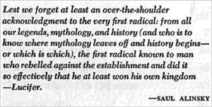
Dedication page in Saul Alinsky’s book:
Rules For Radicals

Slide 144

David Horowitz www.frontpagemag.com
The politics of personal destruction is an inevitable weapon of choice for radicals. If your goal is a just world [Social Justice], then the moral code you live by requires you to wage war without quarter.”

Slide 145

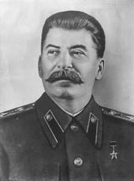
David Horowitz www.frontpagemag.com
Conservatives embrace the system. They believe in its rules of fairness and inclusion. But these rules can also be used by its cynical enemies to destroy it. As [Saul] Alinsky’s hero Lenin put it, “The capitalists will sell us the rope to hang them.” Or as Alinsky’s own “fourth rule of power tactics” puts it: “Make the enemy live up to its own rules.”

Slide 146
David Horowitz www.frontpagemag.com
“There is no real parallelism in the war which radicals have declared. One side is fighting with a no-holds-barred, take-no-prisoners battle plan against the system, while the other is trying to enforce its rules of fairness and pluralism. This is the Achilles’ heel of democracies and all radical spears are aimed in its direction.”

Slide 147
David Horowitz, www.frontpagemag.com
Barak Obama’s Rules for Revolution: The Alinsky Model
David Horowitz Freedom Center
P.O.Box 55089
Sherman Oaks, CA91499
1 800 752-6562
ISBN: 1-886442-68-1
25 or more = $1.00 each

Slide 148

Proverbs 27:12
“A prudent man foreseeth the evil, and hideth himself; but the simple pass on, and are punished.”

Slide 149

Ludwig von Mises,
“Human Action,” 1966, p. 572
“There is no means of avoiding the final collapse of a boom brought about by credit expansion [Fannie Mae and Freddie Mac; especially if the credit is extended to people who knowingly cannot pay it back]. The alternative is only whether the crisis should come sooner as the result of voluntary abandonment of further credit expansion or later as a final and total catastrophe of the currency system involved.”

Slide 150
Daniel Webster, 1823
“If the evangelical volume does not reach every hamlet, the pages of a corrupt and licentious literature will. If religious books are not widely circulated among the masses in this country, I do not know what is going to become of us as a nation.”

Slide 151
Question:
What is another strategy that the usurpers are using as they are currently attempting to steal away from us the God-given freedoms, liberty and constitutional rule of our country, the United States of America?

Slide 152
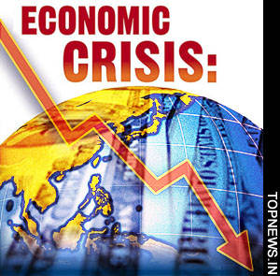

One strategy is to invent a life-threatening crisis and then constantly warn us of our coming destruction and impending doom.

Slide 153
Climate Change is a political strategy of Socialists.
Strategy: Create a life-threatening global crisis such as global warming.
Advertise the crisis repeatedly. (Gore in schools, TWC.)
Gain a critical mass of people. (using media, PC)
Pass laws that restrict industry and freedom.
Increase central government control and increase taxes.
Confiscate corporate and private property
Abolish the free-market economic system.
Establish a two class civilization:
The Elites
    And everyone else (slaves with no rights?).

Slide 154
An example of the socialist agenda of a two class society:
USA Today, Friday December 10, 2010, p. 3A
Headline: “Ambassador singled out for pat-down”
Jackson, MS. – “Secretary of State, Hillary Rodham Clinton, expressed concern Thursday over the pat-down of India’s sari-clad ambassador to the U.S. at the airport here over the weekend, an incident that has prompted calls for an apology from Washington.

Slide 155
USA Today continued:
Indian Foreign Minister S.M. Krishna called the pat-down “unacceptable” and said his nation would complain to the U.S. government…. “We are going to take it up with the government of the United States, and I hope that things could be resolved so that such unpleasant incidents do not recur,” Krishna said.
Virander Paul, a spokesman for the India’s Washington Embassy, said the State Department had “reached out to the ambassa-

Slide 156
dor and has regretted what happened.”
“The way they pat them down—it was so humiliating,” said Tan Tsai, a research associate at MSU who was with Shanker. “Anybody who passed by could see it.”
Oh my, oh my—one of the elites had to endure the “humiliating” pat-down that all of us as law-abiding citizens must endure or we get sent to jail, but a non-citizen gets an apology from our compassionate State Department!

Slide 157
This is like the elites exempting themselves from the Obamacare socialist medical takeover which we law-abiding American citizens must accept and be subject to which includes “Death Panels” for those over 65 years old. Of course the “Death Panels” will be regulated and overseen by the most compassionate of beaurocrats!

Slide 158
Universal Health Care
“The health care bill had very little to do with health care. It had everything to do with unionizing millions of hospital and health care workers, as well as adding 15,000 to 20,000 new IRS agents (who will join government employee unions). Obama doesn't care that giving free health care to 30 million Americans will add trillions to the national debt….

Slide 159

What he does care about is that it [Obama’s Socialized Medicine] cements the dependence of those 30 million voters to Democrats and big government. Who but a socialist revolutionary would pass this reckless spending bill in the middle of a depression?”
~Wayne A. Root

Slide 160
“Barrack Obama is no fool. He is not incompetent. To the contrary, he is brilliant. He knows exactly what he's doing. He is purposely overwhelming the U.S. economy to create systemic failure, economic crisis and social chaos -- thereby destroying capitalism and our country from within.” ~Wayne A. Root

Slide 161
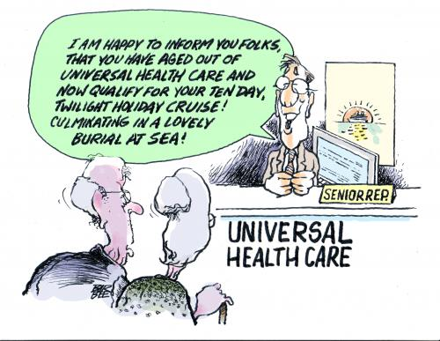
http://www.toonpool.com/cartoons/UNIVERSAL%20HEALTH%20CARE_37320

Slide 162
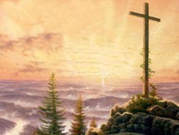
Hebrews 10:32-33
“But call to remembrance the former days, in which, after ye were illuminated, ye endured a great fight of afflictions; ³³Partly, whilst ye were made a gazingstock both by reproaches and afflictions; and partly, whilst ye became companions of them that were so used.

Slide 163
Hebrews 10:34
“For ye had compassion of me in my bonds, and took joyfully the spoiling of your goods [“…accepted joyfully the seizure of your property” NAS], knowing in yourselves that ye have in heaven a better and an enduring substance.”

Slide 164
Hebrews 10:35-37
“Cast not away therefore your confidence, which hath great recompence of reward. ³⁶For ye have need of patience, that, after ye have done the will of God, ye might receive the promise. ³⁷For yet a little while, and he that shall come will come, and will not tarry.”

Slide 165

1 Thessalonians 4:15-18
“For this we say unto you by the word of the Lord, that we which are alive and remain unto the coming of the Lord shall not prevent them which are asleep. ¹⁶For the Lord himself shall descend from heaven with a shout, with the voice of the archangel, and with the trump of God: and the dead in Christ shall rise first: ¹⁷Then we which are alive and remain shall be caught up together with them in the clouds, to meet the Lord in the air: and so shall we ever be with the Lord. ¹⁸Wherefore comfort one another with these words.”

Slide 166
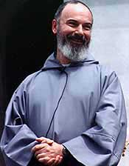
“At a time when it surely seems that capitalism has run amuck and poised the world on the edge of economic ruin, the temptation is very strong for the pendulum to swing too far left into the failed and immoral territory of socialism. Historically pure socialism has never worked, philosophically it cannot work, and morally it is inherently evil (because it undermines the right of private property ownership, an inherent human right) and hence should not be given a chance to work.”
Fr. John Corapi

Slide 167
Corapi continues:
“The response might be that what we have at the moment isn’t pure socialism. The problem is that the moment is incredibly fluid and the direction toward a more radical form of socialism is under way with frightening speed. Unless, of course, you believe the politicians and their appointees whose stock-in-trade has become lies, deception, and self-interest.”

Slide 168
Fr. John Corapi concludes:
“The common error is to think that socialism helps the poor and disenfranchised. As Pope Leo XIII pointed out as long ago as 1891 in his Encyclical ”Rerum Novarum”, socialism does not help the poor. Rather, it reduces everyone [except the elites] to the same lowest common denominator of poverty and misery, while at the same time drying up the very sources of capital.”

Slide 169
Socialism destroys the Middle Class!

Slide 170
Socialism is evil Walter E. Williams
July 28, 2004
“What is socialism? We miss the boat if we say it's the agenda of left-wingers and Democrats. According to Marxist doctrine, socialism is a stage of society between capitalism and communism where private ownership and control over property are eliminated. The essence of socialism is the attenuation and ultimate abolition of private property rights…

Slide 171

Walter Williams
Attacks on private property include, but are not limited to, confiscating the rightful property of one person and giving it to another to whom it doesn't belong. When this is done privately, we call it theft. When it's done collectively, we use euphemisms: income transfers or redistribution….” www.townhall.com.

Slide 172
Walter Williams
“Can a moral case be made for taking the rightful property of one American and giving it to another to whom it does not belong? I think not. That's why socialism is evil. It uses evil means (coercion/[taxes]) to achieve what are seen as good ends (helping people). We might also note that an act that is inherently evil does not become moral simply because there's a majority consensus.”

Slide 173
Walter Williams
“An argument against legalized theft should not be construed as an argument against helping one's fellow man in need. Charity is a noble instinct; theft, legal or illegal, is despicable. Or, put another way: Reaching into one's own pocket to assist his fellow man is noble and worthy of praise. Reaching into another person's pocket to assist one's fellow man is despicable and worthy of condemnation.

Slide 174
Walter Williams
“For the Christians among us, socialism and the welfare state must be seen as sinful. When God gave Moses the commandment "Thou shalt not steal," I'm sure He didn't mean thou shalt not steal unless there's a majority vote. And I'm sure that if you asked God if it's OK just being a recipient of stolen property, He would deem that a sin as well.”

Slide 175

F. A. Hayek
As the distinguished political economist F. A. Hayek has stated: “The guiding principle that a policy of freedom for the individual is the only truly progressive policy remains as true today as it was in the nineteenth century.”

Slide 176
Socialism and the Welfare State
The dangers of the Welfare State are 1) it is unjust in taking lawful property from individuals through excessive taxation, 2) it substitutes the collective judgment of the government for the freedom and judgment of the individual 3) it discourages initiative and entrepreneurship by individuals, and 4) it leads to excessive government power and hence corruption.

Slide 177
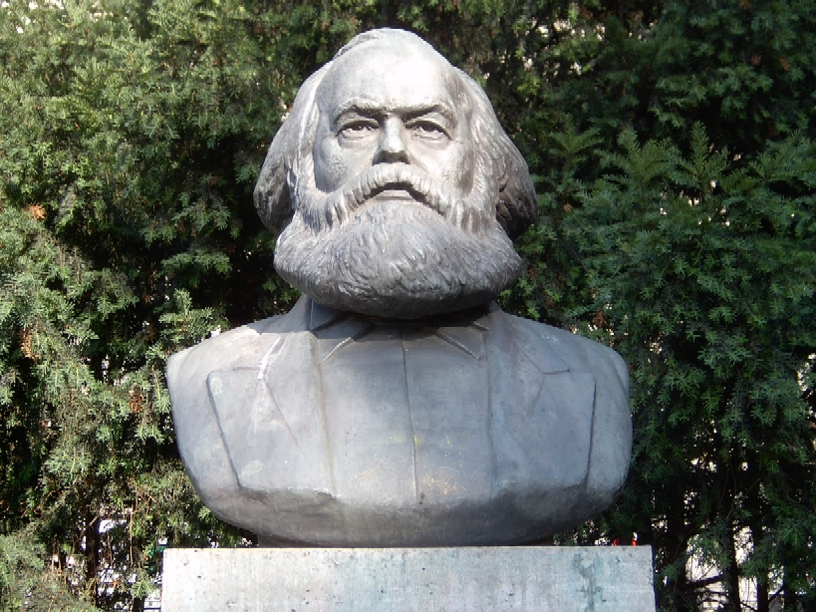
Karl Marx
“Democracy is the road to socialism.”

Slide 178

V.I. Lenin
“Democracy is indispensable to socialism. The goal of socialism is communism.”

Slide 179

Karl Marx
“The meaning of peace is the absence of opposition to socialism.”
I warned you this would happen.

Slide 180

Winston Churchill

Slide 181
Fabian Socialist Society of Britain
In 1883 and 1884 an organization dedicated to promoting socialist theory was founded in London, England. Named the Fabian Society after a Roman general of the 3rd century BC, Quintas Fabius Maximus Cunctator, its goal was the establishment of a democratic socialist state in Great Britain. Socialism was the dominant new economic and political doctrine of the 19th century. Its aim was economic democracy--the redistribution of wealth among all classes in society through the public ownership of all business and industry.

Slide 182

The ideas and practices of the Marxist- Socialists and Fabian Socialists have invaded our schools and universities. Our children and grandchildren are being drawn away from their Christian roots by the thousands.

Slide 183

The children are taught from the earliest ages that they are citizens of a global village. They must learn and accept the idea that the personal must be sacrificed for the community— “I must use what I have to benefit the less fortunate and I must follow the dictates of my government because it knows what is best for all of us.”

Slide 184
We, and especially our children and grandchildren, are facing a huge trial by fire in our country.
According to recent statistics up to 89% of our children raised in evangelical homes are forsaking Biblical Christianity for other worldviews which do not believe or teach the Gospel of our crucified and bodily resurrected Lord Jesus Christ.

Slide 185
1 Peter 4:12-14
“Beloved, think it not strange concerning the fiery trial which is to try you, as though some strange thing happened unto you: ¹³But rejoice, inasmuch as ye are partakers of Christ’s sufferings; that, when his glory shall be revealed, ye may be glad also with exceeding joy. ¹⁴If ye be reproached for the name of Christ, happy are ye; for the spirit of glory and of God resteth upon you: on their part he is evil spoken of, but on your part he is glorified.”

Slide 186
Luke 6:22-23
“Blessed are ye, when men shall hate you, and when they shall separate you from their company, and shall reproach you, and cast out your name as evil, for the Son of man’s sake. ²³Rejoice ye in that day, and leap for joy: for, behold, your reward is great in heaven: for in the like manner did their fathers unto the prophets.”

Slide 187
Some up to date statistics:
Some up to date statistics:

Slide 188
There are two ways, two paths to walk on through this life:
The Way of the Word
Or
The way of the world: Satan’s world system.

Slide 189
Dedication page in Saul Alinsky’s book:
Rules For Radicals

Slide 190
++++++++++++++++++++++
Winston Churchill: Never, No Never, No Never
Give up!
http://www.google.com/imgres?imgurl=http://www.reagantopalin.com/wp-content/uploads/2009/11/M93Never-Give-Up-Winston-Churchill-Posters.jpg&imgrefurl=http://www.reagantopalin.com/2009/11/okay-so-we-didnt-win-ny-23-but-sometimes-you-lose-a-battle-on-the-way-to-winning-the-war/&usg=__6_0rbF4f6CkrOY8wgOz51jHbvdQ=&h=407&w=400&sz=19&hl=en&start=20&zoom=1&itbs=1&tbnid=WWWmBqS3SSYT8M:&tbnh=125&tbnw=123&prev=/images%3Fq%3Dwinston%2Bchurchill%26hl%3Den%26sa%3DX%26gbv%3D2%26tbs%3Disch:1

Slide 191
1 Corinthians 15:50-58
⁵¹Behold, I shew you a mystery; We shall not all sleep, but we shall all be changed, ⁵²In a moment, in the twinkling of an eye, at the last trump: for the trumpet shall sound, and the dead shall be raised incorruptible, and we shall be changed. ⁵³For this corruptible must put on incorruption, and this mortal must put on immortality. ⁵⁴So when this corruptible shall have put on incorruption, and this mortal shall have put on immortality,

Slide 192
then shall be brought to pass the saying that is written, Death is swallowed up in victory.
⁵⁵O death, where is thy sting? O grave, where is thy victory? ⁵⁶ The sting of death is sin; and the strength of sin is the law. ⁵⁷But thanks be to God, which giveth us the victory through our Lord Jesus Christ.
⁵⁸ Therefore, my beloved brethren, be ye stedfast, unmoveable, always abounding in the work of the Lord, forasmuch as ye know that your labour is not in vain in the Lord.

Slide 193
Some ideas from Manfred Kober with anecdotal notes from me now follow….

Slide 194
We labor individually and corporately for our Lord.
Our Lord deals with us individually and, as well, corporately.
He deals with us as specific, individual people
He deals with us corporately or federally as families, churches, and nations. The Bible addresses all of these entities.

Slide 195
The 10 commandments are addressed to the nation of Israel=God is laying down the Law for the people of Israel corporately, federally.
Of course these laws also apply to us individually.

Slide 196
God has ordained 3 institutions for the benefit of mankind: the home, the church and civil government.

Slide 197
The Bible has God’s principles explaining what makes a godly family, a godly church and a great and godly nation.

Slide 198
If a nation follows divine directives, it can expect God to promote it, to protect it, and to preserve it.

Slide 199
In my opinion the USA has been uniquely blessed by our God of the Bible more than any other nation except Israel under David and Solomon. One Jewish and one Gentile nation.
The blessings have come to USA because certain things are true in our country’s background that are not true at all or only partially true of other nations.

Slide 200
Why has God uniquely blessed USA?
God has certain principles that apply to nations and these principles and the effects of these principles continue from generation to generation.
Because the effects of these principles continue, God’s blessings will also continue.
God stands on His Word!

Slide 201
Predictions concerning our country’s demise are premature. In our founding history certain features are absent from other nations.
Our country was founded for the purpose of freedom in the Christian religion.
Our country was founded by Christian people seeking to freely practice their Faith.
This may possibly give us hope for the future!

Slide 202
ExODUS 20:1-4
¹And God spake all these words, saying, ²I am the LORD thy God, which have brought thee out of the land of Egypt, out of the house of bondage. ³Thou shalt have no other gods before me. ⁴Thou shalt not make unto thee any graven image, or any likeness of any thing that is in heaven above, or that is in the earth beneath, or that is in the water under the earth:

Slide 203
Exodus 20:5-6
⁵Thou shalt not bow down thyself to them, nor serve them: for I the LORD thy God am a jealous God, visiting the iniquity of the fathers upon the children unto the third and fourth generation of them that hate me; ⁶And shewing mercy unto thousands of them that love me, and keep my commandments.

Slide 204
In Exodus 20 God is delivering His laws to the fledgling country of Israel (corporately, federally).
If the country is begun by an ungodly, idolatrous people who disobey God’s commandments God would bring down His punishment to the third and fourth generations.

Slide 205
If a nation is initiated by a group of godly founding fathers, God will bless that nation to a thousand generations (see: Deuteronomy 7:9 for the translation “generations.”)
^{9”}Know therefore that the LORD thy God, he is God, the faithful God, which keepeth covenant and mercy with them that love him and keep his commandments to a thousand generations.”

Slide 206
The premise of Exodus 20:5:
God will bless even the remote descendants of a godly people.
Our nation, more than any other nation, was established by a group of godly men and women for God’s glory and praise!
Though rejected by revisionist historians, this truth can be demonstrated from early American documents.

Slide 207
The mayflower compact:
The Mayflower compact was framed in 1620 by the first permanent English settlers in North America.
The M. compact documents three reasons for their settlement:
  1. …having undertaken for the glory of God,
  2. the advancement of the Christian Faith,
  3. and the honor of King and country…”

Slide 208
Our Pilgrim fathers loved God, loved the Gospel and loved their mother country.
Even Jamestown (1607), founded as a strictly economic venture agreed to the founding documents of Virginia which said in part:

Slide 209
Jamestown,Virginia…. Which may, by the Providence of Almighty God, hereafter tend to the glory of His Divine Majesty, in propagating of the Christian Religion to such People as yet live in darkness and miserable ignorance of the true Knowledge and Worship of God….

Slide 210
As we all know, not every colonist in those formative years was a Christian, but on those early vessels there came not just sailors, soldiers, servants and scoundrels, but many SAINTS. These saints helped lay the foundation in each colony. Their Christian piety influenced the colonial politics. They had one overriding passion: to share the Gospel!
It is they who qualify for the promise of Exodus 20:6!!

Slide 211
Another biblical principle:
Genesis 12:3: “ ³And I will bless them that bless thee, and curse him that curseth thee: and in thee shall all families of the earth be blessed.

Slide 212
The principal of Genesis 12:3 is clear: God will deal with the nations in accordance with how they treat the nation of Israel!
Those nations who protect and promote Israel will experience the blessing of God. Those nations who persecute Israel will be cursed by God.

Slide 213
Jeremaih 30:20
In speaking of the Jewish people God says, “Their children also shall be as aforetime, and their congregation shall be established before me, and I will punish all that oppress them.”
History is replete with illustrations of nations that persecuted Israel and the God of Israel in turn punished them.

Slide 214
Where are the mighty Assyrians? Where are the militaristic Babylonians? Their empires crumbled. Why did they disappear? There is one major reason for demise of these people—They touched God’s people! Israel is God’s special treasure even when they are in unbelief! He calls His people “the apple of His eye.”

Slide 215
Deuteronomy 32:9-10
⁹For the LORD’S portion is his people; Jacob is the lot of his inheritance. ¹⁰He found him in a desert land, and in the waste howling wilderness; he led him about, he instructed him, he kept him as the apple of his eye.

Slide 216
Zechariah 2:8
⁸For thus saith the LORD of hosts; After the glory hath he sent me unto the nations which spoiled you: for he that toucheth you toucheth the apple of his eye.

Slide 217
The USA and israel—two friends
The USA holds a unique place among the world’s nations. Unlike other nations we have provided for Israel and for Israeli refugees as long as we have existed as a country.
The first refuge in history with full freedom for persecuted Jews was called Rhode Island.

Slide 218
Roger Williams encouraged all persecuted people, especially Jews, to come and settle in Rhode Island.
The first synagogue, the Touro Synagogue, was established by Jewish worshippers of Newport, Rhode Island in 1656!

Slide 219
Our nation’s history demonstrates that we have never been guilty of persecuting the Jewish people, but have helped them more than any other nation in history.

Slide 220
When a nation attacks Israel in any way, the God of the “Apple of God’s Eye,” (Israel), Who is our God responds!
Eye to Eye: Facing the Consequences of Dividing Israel, Bill Koenig, (Alexandria, VA: About Him Publishing, 2006), 330 pages.

Slide 221


Slide 222
⁶Pray for the peace of Jerusalem: they shall prosper that love thee.
Psalm 122:6

Slide 223
10/30/ 1991: VP George Bush opened the Madrid Conference aimed at forcing Israel to give up more land. Near the same time, a storm formed in the Atlantic. It traveled in an unusual direction and sent 35 ft waves into Bush's New England home.

Slide 224
8/23/1992: Madrid Conference moved to Washington, D.C. That same day, Hurricane Andrew, the worst natural disaster in US history at that time, caused over $30 billion in damage and left 180,000 homeless.

Slide 225
1/16/1994: President Clinton met with Syria's President for talks on forcing Israel to give up the Golan Heights. Less than 24 hours later, a 6.9 earthquake shook Southern California. It was the second most destructive natural disaster to hit the US.

Slide 226
3/1/1997: Yassar Arafat, head of the Palestine Liberation Organization, toured America. He was in the US for one month, leaving the first part of April. On the day he landed in the US, powerful tornadoes devastated huge sections of Texas, Arkansas, Tennessee, Kentucky, Mississippi and the Dakotas. These storms led to the worst flooding in the 20th Century. On the day he left, the storms ceased.

Slide 227
1/21/1998: Israeli Prime Minister Netanyahu met with President Clinton. The Prime Minister was coldly received by Mr. Clinton because he flatly refused to give up more of Israel's land. Clinton and Secretary of State Madeline Albright refused to have lunch with him. A few hours later, the Monica Lewinsky scandal broke over Clinton's head.

Slide 228
9/28/1998: Yassar Arafat addressed the United Nations in New York and stated that he would declare a Palestinian state by May 1999. As he said these words, Hurricane George pounded the Gulf Coast and caused $1 billion in damages. At the exact time Arafat left the US, the storm faded.

Slide 229
8/29/2005: President George W. Bush pressured Israel to evacuate from the Gaza Strip. 8,000 Israeli settlers were forced to leave their homes and villages. Exactly one week later, Hurricane Katrina smashed Louisiana, Mississippi and Alabama. 80% of the city of New Orleans was under water. The percentage of the Israeli population that was made homeless by the forced evacuations was almost exactly equal to the same percentage of the American population left homeless by Katrina.

Slide 230
3/23/2010: Prime Minister Netanyahu arrived at the White House to meet with Obama. Instead of being taken through the front door, he was taken through a side door, an apparent act of humiliation. No press corps was invited and no friendly photos taken . Instead, he was harshly addressed by Obama and then was left to sit alone while Obama had lunch with his family. Obama's parting remarks were, "If you come up with anything new, call me." The Prime Minister flew home. In 48 hours, huge storms caused massive flooding in the US, the worst in 200 years.

Slide 231
4/19/2010: Before the United Nations, Obama stated that the United States will no longer automatically side with Israel at the UN. This was the first time that any US President had made such a statement. On April 19, Israel was celebrating her rebirth as a nation, since the Jewish Calendar is a lunar calendar, unlike our solar calendar, which would have had that birthday in May. Within 24 hours of the Obama statement, the British Petroleum oil well exploded killing 11 in the Gulf of Mexico. This was the worst natural disaster in American history.

Slide 232
5/19/2011: Obama embraced the Palestinian demand for Israel to return to the 1967 borders, which Israel has declared would be asking her to commit national suicide. This was a radical departure for the government of the United States. Three days later on Sunday, May 22, 2011, the deadliest single tornado since 1953 tore through Joplin, Missouri, destroying almost half the city and killing 117. A tornado hit Minneapolis also.

Slide 233
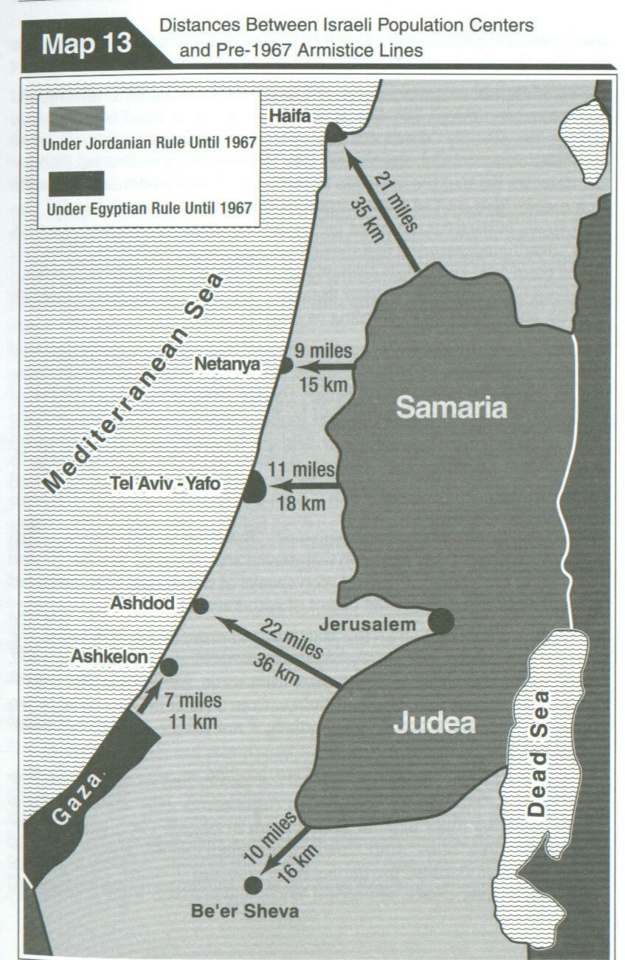

Slide 234
Genesis 12:3 –
“And I will bless them that bless thee, and curse him that curseth thee: and in thee shall all families of the earth be blessed.”

Slide 235
In Genesis 12:3 God promised continuous blessings upon those who bless Israel. Our nation has had many differences with Israel but it has never yet failed to promote and protect Israel! And God has continued to bless America, in spite of our waywardness and unbelief as a nation.

Slide 236
Genesis 18:23-26
^{23”}And Abraham drew near, and said, Wilt thou also destroy the righteous with the wicked?”
Let us turn in our Bibles to Genesis 18:23ff.

Slide 237
Genesis 18:23
The main point of the passage is clear: God is very reluctant to destroy a wicked place with even a few righteous people in it.
God will normally not destroy the wicked without first delivering the godly.

Slide 238
God always judges sin….
God has not forgotten the sins of America and will settle the score someday, but the just judge (Genesis 18:25) will not allow the righteous to perish with the wicked.

Slide 239
The Lord was patient (as his desire is that no one should perish) with the unrighteous of Noah’s day, but ultimately destroyed them all, delivering only righteous Noah and his family.
God would not destroy the corrupt cities without first rescuing that one righteous person, Lot.

Slide 240
2 Peter 2:6-9
6. And turning the cities of Sodom and Gomorrha into ashes condemned them with an overthrow, making them an ensample unto those that after should live ungodly; And delivered just Lot, vexed with the filthy conversation of the wicked: ⁸(For that righteous man dwelling among them, in seeing and hearing, vexed his righteous soul from day to day with their unlawful deeds;) ⁹The Lord knoweth how to deliver the godly out of temptations, and to reserve the unjust unto the day of judgment to be punished.

Slide 241
God is very reluctant to destroy a wicked place with even a few righteous people in it!

Slide 242
God is not about to destroy our wicked nation until and unless the believers are removed into His Holy Presence.
The principle of God not judging a nation or the world without first removing His saints applies to USA in this writer’s opinion.
This is support for a Pre-Tribulation Rapture.

Slide 243
After Believers are removed, God then brings down His well-deserved and long-delayed judgment.
Up until the present, the USA has the preponderance of Christians. Many thousands of Bible-believing churches and millions of Bible-believing Christians.

Slide 244
It seems that because of the righteous saints in America and our support of Israel, our God has up until the present exalted our nation among the nations.

Slide 245
Acts 17:26
²⁶And hath made of one blood all nations of men for to dwell on all the face of the earth, and hath determined the times before appointed, and the bounds of their habitation.

Slide 246
God determines the borders of all the nations and the duration of their existence.

Slide 247
Ephesians 1:11
¹¹In whom also we have obtained an inheritance, being predestinated according to the purpose of him who worketh all things after the counsel of his own will: ¹²That we should be to the praise of his glory, who first trusted in Christ.

Slide 248
Daniel 4:34-35
I praised and honoured him that liveth for ever, whose dominion is an everlasting dominion, and his kingdom is from generation to generation: ³⁵And all the inhabitants of the earth are reputed as nothing: and he doeth according to his will in the army of heaven, and among the inhabitants of the earth: and none can stay his hand, or say unto him, What doest thou?

Slide 249
Psalm 115:1-3
¹Not unto us, O LORD, not unto us, but unto thy name give glory, for thy mercy, and for thy truth’s sake. ²Wherefore should the heathen say, Where is now their God? ³But our God is in the heavens: he hath done whatsoever he hath pleased.

Slide 250
The Lord has special preservation and unique purposes for every nation until their wickedness can no longer go unpunished. He will accomplish His purposes!

Slide 251
Romans 8:28
²⁸And we know that all things work together for good to them that love God, to them who are the called according to his purpose.

Slide 252
The USA is not specifically mentioned in the Bible. We cannot point to a specific Scripture that lays out God’s overall plan for America.
This Scriptural silence is compensated for by the frequent observations of our Founding Fathers concerning the Divine Design for America.

Slide 253
Remember the First Charter of Virginia: the main purpose of the first English settlement was to the “propagating of Christian religion to such people as yet live in darkness.”
Remember the first permanent English settlement in Plymouth was established (Mayflower Compact) “for the glory of God and advancement of the Christian faith.”

Slide 254
Most of the original charters of the states in USA spell out that their main reason for existence is to “proclaim the Christian Gospel.”

Slide 255
Looking back in history it appears that God has at least three major purposes for the USA:
  To provide for and protect the Jewish people,
  To be the hope of the unsaved,
  To be a home for the oppressed.

Slide 256
America, however imperfectly, has been true to its destiny.
We have been a lighthouse for the Gospel
We send out and support more Christian missionaries and missions than any other country.
We have welcomed the oppressed.

Slide 257
As long as we are faithful to our destiny God will faithfully protect and provide for our USA.

Slide 258
Some people say that America will be conquered by Russia, China or the Moslems.
If USA were conquered by another nation today, that victorious nation would be in charge of a world empire tomorrow. But according to Daniel 2 and 7, there can be four and only four world empires between Nebuchadnezzar’s time (606 BC) and Christ’s kingdom on earth (1000 years).

Slide 259
The existence of America until the rapture
There appear to be some discernible reasons why God has raised our country and will most likely preserve it until the rapture.
The USA is the primary sender and supporter of Christian missionaries.
America protects God’s chosen people.
America provides a home for the politically and religiously persecuted people of the world.

Slide 260
Revelation 22:12-14
¹²And, behold, I come quickly; and my reward is with me, to give every man according as his work shall be. ¹³I am Alpha and Omega, the beginning and the end, the first and the last. ¹⁴Blessed are they that do his commandments, that they may have right to the tree of life, and may enter in through the gates into the city.

Slide 261
Revelation 22:16-17
¹⁶I Jesus have sent mine angel to testify unto you these things in the churches. I am the root and the offspring of David, and the bright and morning star. ¹⁷And the Spirit and the bride say, Come. And let him that heareth say, Come. And let him that is athirst come. And whosoever will, let him take the water of life freely.

Slide 262
Revelation 22:20-21
²⁰He which testifieth these things saith, Surely I come quickly. Amen. Even so, come, Lord Jesus. ²¹The grace of our Lord Jesus Christ be with you all. Amen.

Slide 263
BIBLIOGRAPHY
None Dare Call It Education: John Stormer
Brave New Schools: Berit Kjos
Education, Christianity, and the STATE: J. Gresham Machen
Christian Education for the Real World: Henry Morris
Why Johnny Can’t Read: Rudolf Flesch
The Victims of Dick and Jane and other essays: Samuel Blumenfeld

Slide 264
WORLDVIEW THINKING IN THE HISTORY OF THE U.S.A.
Christian Theism: Personal God
Young Universe Creation
Traditional Deism: Reduced God
Old Universe Theistic Evolution
Secular Humanism: Dead God
Darwinian Atheistic Evolution
Pagan Mysticism/Metaphysical Naturalism
I am God/All is God/Evolution is God
Harry Potter is God Deut. 18:10; Lev. 19:31 KJV

